Slide 1
Object Oriented Programming using JAVA
Abhilash Bande

Slide 2
Contents
Introduction to Java
Installation
Variables and Methods
Operators
Conditional Flow Control
Arrays
Classes, Objects and Packages
OOPs Concepts
Multithreading
Swing
Strings
Exception Handling
Generics
Collections
Java IO Stream
Multithreading
JDBC Connectivity

Slide 3
Introduction to Java

Slide 4
Introduction to Java
What is Java?
Features
Architecture
Java Applications
How Java program works?
Java Development Kit - JDK
Java Runtime Environment - JRE
Code Structure
Code Compilation
Byte Code Execution
Java Specifications

Slide 5
What is Java?
Java is Object Oriented programming language developed by Sun Microsystems (now owned by Oracle Corporation) in 1991 by James Gosling.
Java is designed to be a platform independent (meaning java code can be run on any operating system without need of any modifications).
Initially it was named as ‘Oak’ and later in 1995 it was renamed to ‘Java’

Slide 6
Features
Java is simple, easy to learn, and has clear syntax.
Java is portable and can run on any machine/platform/operating system with a Java Virtual Machine (JVM).
Java is secure and has built in security features that protects against viruses, malwares and other security threats.
Java is scalable and can handle large-scale applications with ease.
Java is multithreaded, which means it can execute multiple threads simultaneously allowing faster and more efficient execution of program.

Slide 7
Java Architecture
Java has layered architecture consisting of
Java Virtual machine (JVM)
Java Application Programming Interface (API)
Java Development Kit (JDK).
The JVM is the runtime environment for java programs which converts Java byte code into machine code that can be executed on any computer.
The java API is the set of classes and interfaces that provides developers with a variety of tools and functions to build java application.
The JDK is the software development kit that contains tools for developing, testing and debugging java application.

Slide 8
Java Applications
Java is widely used in various fields including web development, mobile app development, game development and Console applications.
Minecraft : a popular game developed
Android OS : a mobile operating system
Amazon Web Services : a cloud computing platform that uses Java

Slide 9
How Java Program works?
Java programs can run on any platform that has a Java Virtual Machine (JVM).
JVM doesn’t understand java code (.java) directly.
The JVM is a software that interprets Java bytecode and executes it on the (host) machine.
It acts as an intermediary between the Java program and the host operating system, providing a platform independent environment for java programs to run.

Slide 10
Java Development Kit - JDK
The JDK is a software development kit that includes tools and libraries for developing java applications
It includes Java compiler that converts Java source code into Java bytecode that can be executed by the JVM.
It contains JRE and JVM.

Slide 11
Java Runtime Environment - JRE
The JRE is a software package that includes the JVM and other components required to run java application (java packages, classes and libraries).
It does not include the java compiler or other development tools.

Slide 12
JDK, JRE and JVM
JDK
Contains JRE and JVM
Provides all tools (compiler and debugger) to work with java language.
JRE
It contains Java packages, classes and runtime libraries and JVM.
JVM
Provides environment to execute java byte code.
JVM does not understand java code (.java) directly. We have to convert java source code (.java) to java bytecode (.class)
Interpreter which is written in C language which executes the byte code.
It is platform dependant.

Slide 13
Java Code Structure
package com.core;
// import statements
import java.util.List;
public class HelloWorld {
// class variables / data members
// Member functions
// Class constructor
// Getter methods
// Setter methods
// main method
public static void main(String[] args)
{
// statement...
// statement...
// statement...
}
}
Java code is organized into classes and packages.
A class is a template for creating objects, and a package is a collection of related classes.

Slide 14
Java Code Compilation
Java source code is compiled into Java ByteCode using the java compiler.
The Java compiler produces a ‘.class’ file for each class in the code.
javac
Java Source Code
(.java)
ByteCode
(.class)

Slide 15
Java ByteCode Execution
Java Bytecode is executed by the JVM.
The JVM loads the bytecode and interprets it, executing the instructions one by one.
Java compiler
Java Interpreter
Java Source Code
(.java)
ByteCode
(.class)
Native OS

Slide 16
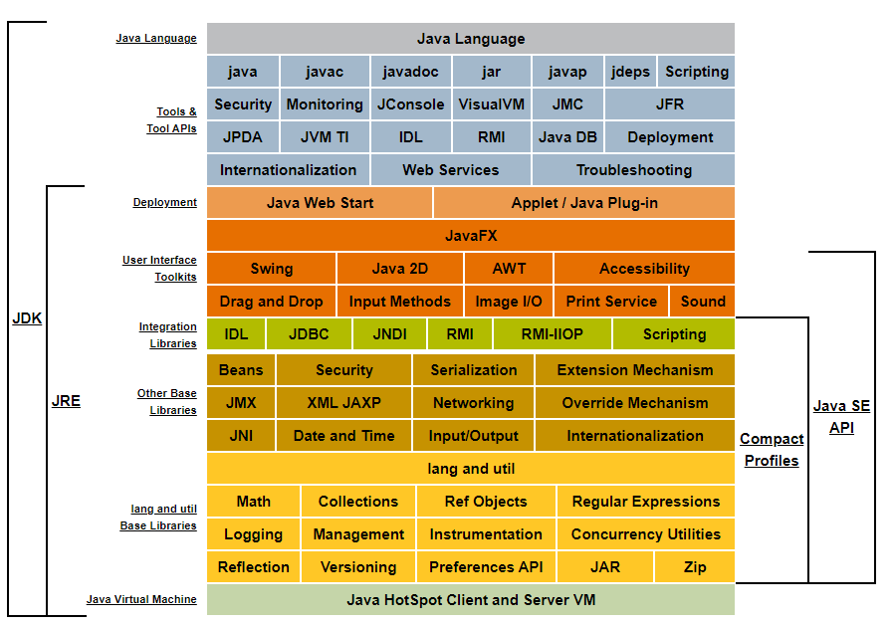
Java
Specifications
Source :
https://docs.oracle.com/javase/8/docs/

Slide 17
Execution of Java Application
Source Code
(.java)
Byte
Code
(.class)
Compiler
(javac)
Java Class Libraries
IO
AWT
NET
…
Class Loader
ByteCode verifier
Native OS
Interpreter
JIT

Slide 18
Naming Conventions
camelCase - methods and variables
PascalCase - classes and Interfaces
UPPERCASE - constants
flatcase - packages
snake_case
Pascal_Snake_Case

Slide 19
Installation

Slide 20
Content
Windows
Linux

Slide 21
Installation on Windows

Slide 22
Installing Java on Windows Machine
To use java on your machine, you need to install JRE
Before installing java, you should check if it is already installed on your computer.
To do this, open command prompt and type ‘java -version’.
If java is installed, the version number will be displayed, otherwise, you will see an error message.
To download Java, go to official website of Java/Oracle
https://www.oracle.com/java/technologies/downloads/
Download required version of JDK (32 bit or 64 bit).
Java 17

Slide 23
Installing Java on Windows Machine
Double click the downloaded file to start the installation process.
Follow on-screen instructions to complete the installation.
If prompted, allow installation to make changes to your computer

Slide 24
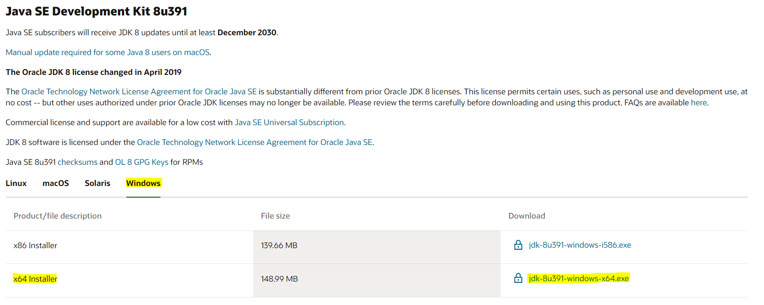

Slide 25
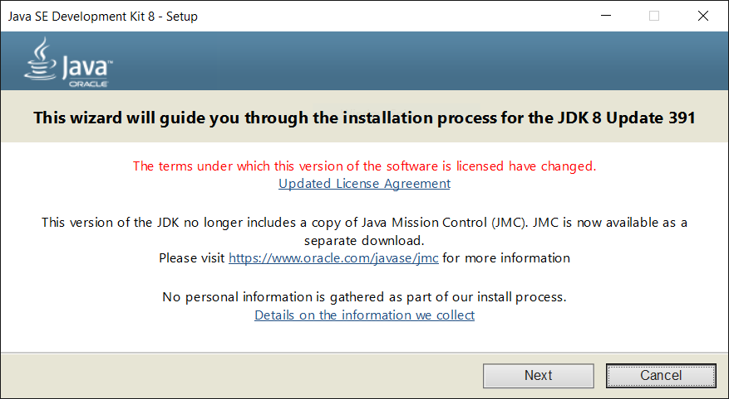

Slide 26
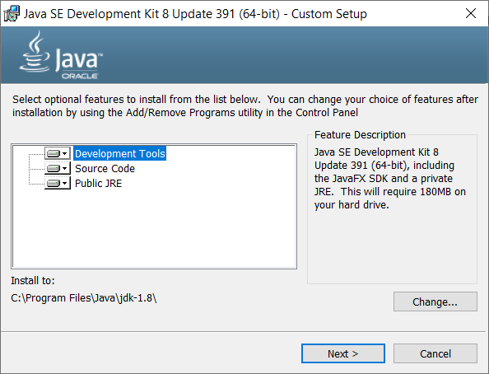

Slide 27
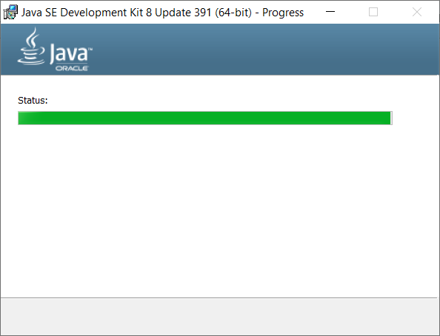

Slide 28
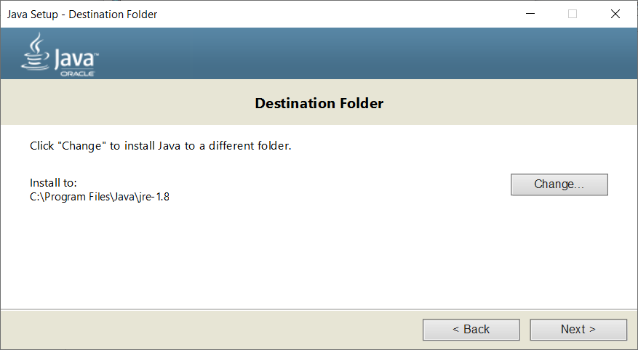

Slide 29
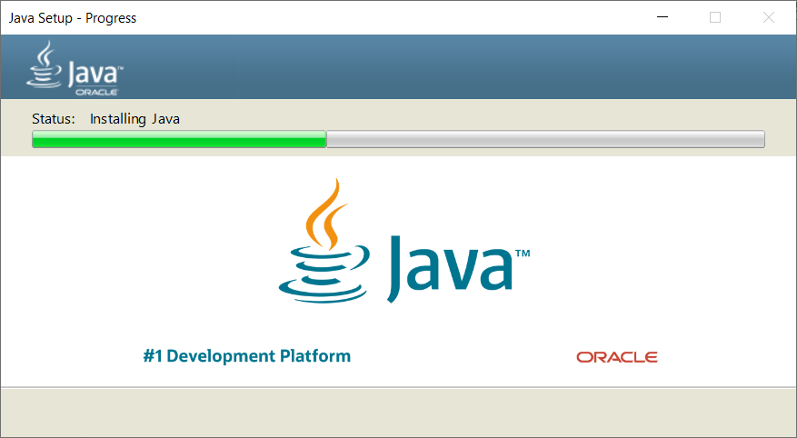

Slide 30
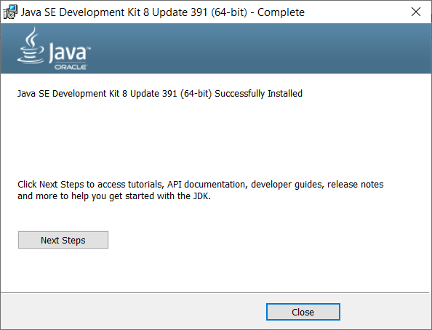

Slide 31
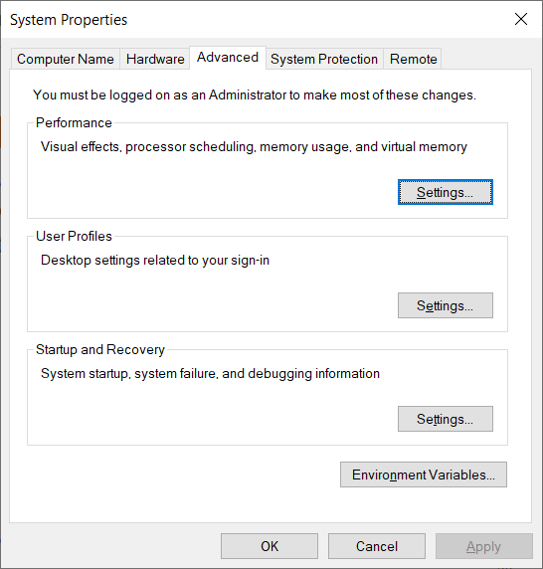
Add to Environment Variables
Open ‘View Advanced System Settings’. (To do that press windows key and type view advanced system settings).

Slide 32
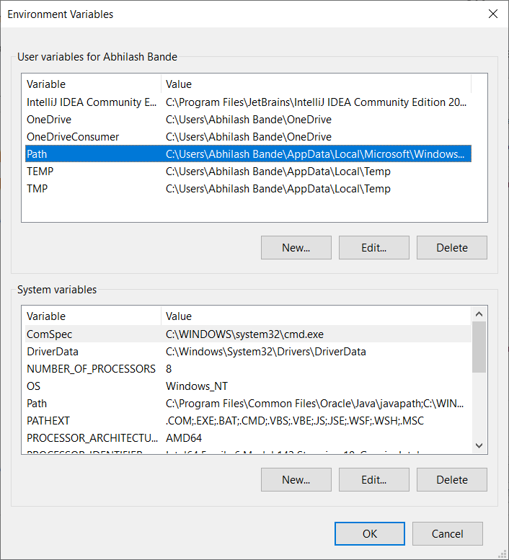
Add to Environment Variables
Click on path→ edit

Slide 33
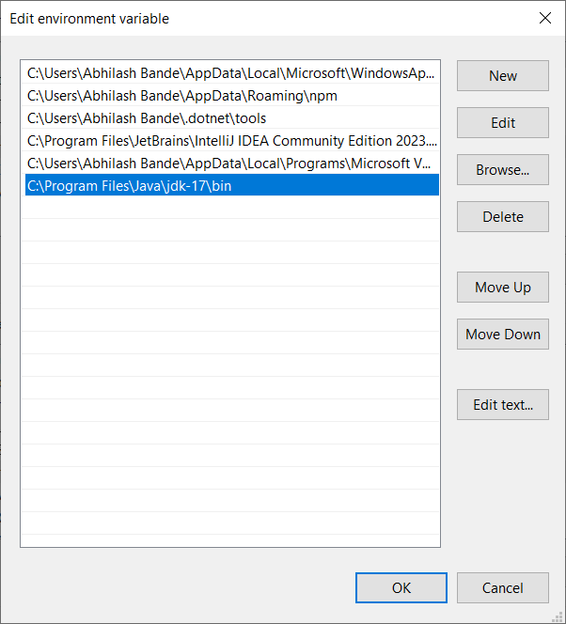
Add to Environment Variables
Add path to the JDK bin directory
C:\Program Files\Java\jdk-17\bin

Slide 34
Verify Java Installation
After installation, you should verify that Java is properly installed on your computer.
To do that, open the command prompt again and type ‘java -version’
If java is installed correctly, the version number will be displayed.

Slide 35
Installation on Linux

Slide 36
Prerequisite
An user account with sudo privileges
Access to the command-line/terminal window
The yum package manager, included by default.

Slide 37
Installation on CentOS
Update the package repository to ensure you download the latest software.
sudo yum update
Then, install the JDK with the following command
sudo yum install java-11-openjdk-devel

Slide 38
Local Install
You have to download the .rpm package from the Java SE download page.
After downloading, you can install the package using following command.
Sudo yum localinstall jdk-VERSION-linux-x64.rpm
Following command will confirm the installation
java -version

Slide 39
Set Environment Variables
First, locate where java is installed
sudo update-alternatives --config java
Once you locate the path, copy the path.
Then open the .bash_profile with any text editor.
At the bottom of the file, add a line which specifies the location of JAVA_HOME in the following manner.
JAVA_HOME=’/usr/lib/jvm/java-11-openjdk-11.0.3.7-0.el7_6.x86_64/bin/java’

Slide 40
IDE Installation

Slide 41
Eclipse
Eclipse is an integrated development environment (IDE) used in computer programming
Eclipse is written mostly in Java and its primary use is for developing Java applications, but it may also be used to develop applications in other programming languages via plug-ins, including C, C++, C#, JavaScript, PHP, Python, R, Ruby etc
https://www.eclipse.org/downloads/

Slide 42


Slide 43
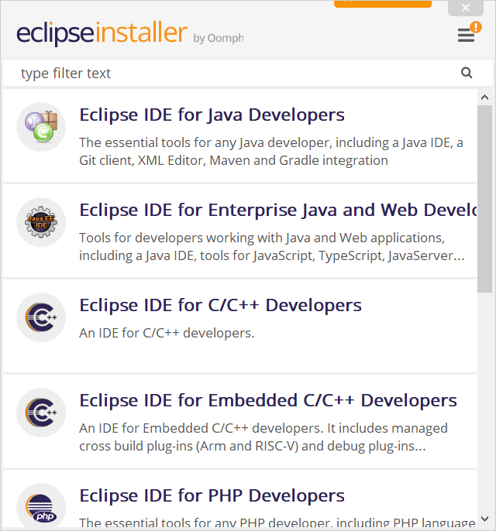

Slide 44
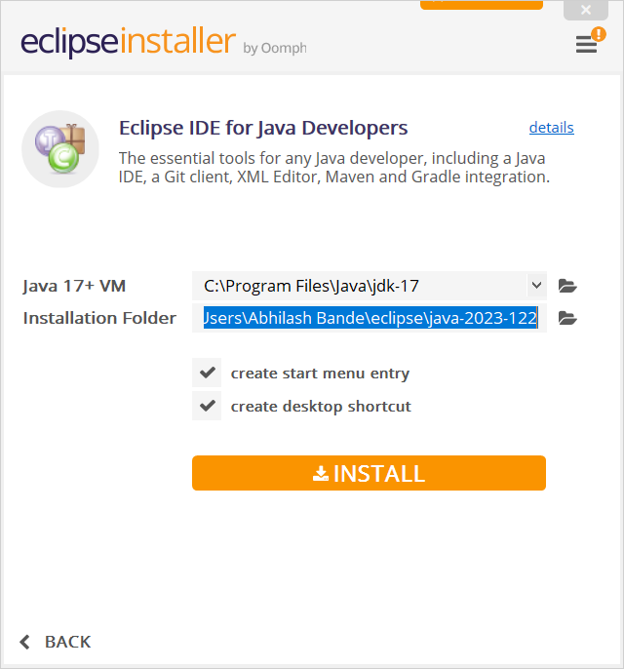

Slide 45
Variables and Data Types

Slide 46
Content
Primitive Data Types
Range
Type Casting
Wrapper classes
Reading inputs from user : Scanner class
Java Methods
Pass by value and pass by reference
Method Overloading
Stack Memory and Heap Memory

Slide 47
Primitive Data Types
Primitive data types in java are predefined by the java language and named as the reserved keywords.
A primitive data type does not share a state with other primitive values.
Java is a strongly typed language, which means that every variable and expression has a specific type that is known at compile time.
In java, there are eight primitive data types that are used to store different kinds of values.
These data types are as follows :
byte | short | int | long
float | double | boolean | char

Slide 48
Data Types Range
Each primitive data type has a specific range of values that it can hold.
byte : This data type is used to store small integer values. It has range of -128 to 127.
short : This data type is used to store short integer values. It has a range of -32,768 to 32,767.
int : This data type is used to store integer values and it has range of -2,147,483,648 to 2,147,483,647.
long : This data type is used to store long integer values and it has range of -9,223,372,036,854,775,808 to 9,223,372,036,854,775,807.
Underscore in Numeric Literals : long number = 10_00_000;

Slide 49
Data Types Range
float : This data type is used to store decimal values with single precision. It has a range of approximately 3.4e-38 to 3.4e+38.
double : This data type is used to store decimal values with double precision. It has a range of approximately 1.7e-308 to 1.7e+308.
boolean : This data type is used to store boolean values (i.e. true or false)
char : This data type is used to store a single character value. It has a range of 0 to 65,535.
char a = 'a'; // character
char a = '\u0041'; // unicode
char a = 65; // ascii

Slide 50
Type Casting
Type casting is a process of converting one data type into another.
In Java, there are two types of type casting : implicit and explicit.
Implicit casting
is done automatically by the compiler
Smaller primitive can automatically fit into larger primitive
Also known as widening
Explicit casting
requires the programmer to explicitly cast the data type.
Converting larger primitive to smaller primitive
Also known as narrowing
Syntax : (target_data_type) value_to_be_casted

Slide 51
Number System
Decimal
Base 10 representation (0 - 9)
Example : 123, 5746
Binary
Base 2 representation (0 and 1)
Example : 1010, 1101, 0b101
Octal
Base 8 representation (0 - 7)
Example : 753, 157, 016
Hexadecimal
Base 16 representation (0 - 9, A - F)
Example : 1A, FF, 23D, 0x23F

Slide 52
Scientific Notation
1,23,00,000
→ 1.23 x 10⁷
→ 1.23e7
0.003
→ 3 x 10⁻³
→ 3.0e-3f

Slide 53
Naming Convention
camalCase – methods and variables
PascalCase – classes and interfaces
UPPERCASE – constants
flatcase – packages

Slide 54
Wrapper Classes
A wrapper class in Java is a class that wraps (encapsulates) a primitive data type, such as int or double, into an object.
This allows the primitive data type tobe used in places where an object is expected, such as collections or method arguments
The wrapper classes are part of the java.lang package, and each wrapper class has a corresponding primitive data type.

Slide 55
Wrapper Classes
Integer i = new Integer(10); // wrapping int value 10 into an integer object
System.out.println(i.intValue()); // output : 10
Double d = new Double(3.14); // wrapping double value into Double object
System.out.println(d.doubleValue()); // output : 3.14

Slide 56
Take inputs from User : Scanner class

Slide 57
Scanner class
The scanner class is a built-in class in Java that allows us to read inputs from users.
To use the Scanner class, we need to first timport it using the following code : import java.util.Scanner;
We can then create an instance of the Scanner class and use its methods to read input from the user.

Slide 58
Creating Scanner Object
To create a scanner object, we can use the following code :
Scanner sc = new Scanner(System.in);
This creates a scanner object named ‘sc’ that is linked to the standard input stream (i.e. System.in).

Slide 59
Reading Inputs
To read a integer type of input from the user, we can use the nextInt() method of the scanner class.
Here is an example :
Scanner sc = new Scanner(System.in);
System.out.print("Enter an int value :: ");
int number = sc.nextInt();
System.out.print("You entered :: " + number);
sc.close();

Slide 60
Java Methods

Slide 61
Methods
In Java, a method is a set of instructions or code that is designed to perform a specific task.
Methods are an essential part of programming in java, as they enable developers to break down complex tasks into smaller, more manageable parts.
Methods are fundamental concept in Java programming, and they allow you to group together a series of statements to perform a specific task.

Slide 62
Defining Methods
Methods are defined using specific syntax that includes a method signature, a return type and a set of parameters.
A method is a block of code or collection of statements or a set of code grouped together to perform a certain task or operation. It is used to achieve reusability of code.
The method signature includes the name of the method and any parameters that are passed to it.
The return type indicates the type of data that the method will return (if any).
public int addNumbers(int number1, int number2) {
int sum = number1 + number2;
return sum;
}

Slide 63
Calling Methods
Once you have defined a method, you can call it from within your program to execute the code within it.
To call a method, you simply specify the method name and required parameters (if any).
int result = addNumbers(10, 20);

Slide 64
void Methods
Not all methods need to return a value. Some methods are designed to perform a specific action without returning any data.
These methods are known as ‘void’ methods and they are defined using the ‘void’ keyword as the return type.
public void printMessage(String msg) {
System.out.println(msg);
}

Slide 65
Pass by value and Pass by Reference
When passing arguments to a java method, there are two ways to do so i.e. pass by value and pass by reference.
In Java, primitive data types are passed by value. It means that a copy of the variable’s value is passed to the method, and not the variable itself.
When method modifies the value of the parameter, it only modifies the copy, not the original variable.

Slide 66
Pass by value and Pass by Reference
In Java, non-primitive data types (arrays and objects) are passed by reference.
It means that the method receives a reference to the original variable, and not a copy of its value.
When the method modifies the value of the parameter, it modifies the original variable.

Slide 67
Stack and Heap memory
Java uses 2 types of memory : stack and heap.
Heap Memory
Heap memory is used for storing arrays and objects
Objects are created on heap using ‘new’ keyword, and references to those objects are stored on the stack.
The JVM automatically manages the heap memory, allocating and deallocating objects as needed.
Stack Memory
Stack memory is faster than heap memory because it is allocated and deallocated automatically by JVM.
Heap memory is slower because JVM has to search for a space to allocate objects.
Stack memory is limited in size whereas heap memory grows dynamically as needed.

Slide 68
Structure of Memory
MEMORY
Data Segment
Local Variables
Stack Area
Movable Boundary
Dynamically Allocated Variables
Heap Area
Fixed Boundary
Global and Static variables
Data Section
Code Segment

Slide 69
Method Overloading
Method overloading is a technique that allows you to define multiple methods with the same name but different parameter lists.
Java uses the number and types of the parameters to determine which method to call.
public int addNumbers(int number1, int number2) {
int sum = number1 + number2;
return sum;
}
public int addNumbers(int number1, int number2, int number3) {
int sum = number1 + number2 + number3;
return sum;
}

Slide 70
Operators

Slide 71
Content
Arithmetic Operators
Assignment (Short-hand) Operators
Relational Operators
Logical Operators
Conditional Operators
Bitwise Operators
Order of Operation

Slide 72
Operators
Operators are symbols that represent various operations that can be performed on one or more operands.
Java supports a wide range of operators that can be used to perform arithmetic, comparison, logical and bitwise operations.

Slide 73
Arithmetic Operators
Arithmetic operators are used to perform mathematical operations on numeric values.
Addition (+) → Adds two values
Subtraction (-) → Subtracts one value from another
Multiplication (*) → Multiplies two values
Division (/) → divides one value by another
Modulus (%) → Returns the remainder of the division
Increment (++) → increments a value by 1
Decrement (--) → decrements a value by 1

Slide 74
Assignment (Short-hand) Operators
Assignment operators are used to assign a value to a variable.
Equals to (=)→ Assigns a value
Plus Equals to (+=) → Adds the value and then assign new value
Minus Equals to (-=) → Subtracts the value and then assign new value
Multiply Equals to (*=) → Multiplies the value and then assign new value
Divide Equals to (/=) → Divides the value and then assign new value
Modulus Equals to (%=) → gets the remainder and then assign new value

Slide 75
Relational Operators
Relational operators are used to compare two numerical values.
Double Equals (==)→ returns true if two operands are equal
Not Equals (!=) → returns true if two operands are NOT equal
Less than (<) → returns true if first operand is less than operand value
Less than or equals to (<=) → returns true if first operand is less than or equals to second operand
Greater than (>) → returns true if first operand is greater than second operand
Greater than or equals to (>=) → returns true if first operand is greater than or equals to second operand

Slide 76
Logical Operators
Logical operators are used to perform logical operations on boolean values.
AND (&&) → returns true if both operands are true
OR (||) → return true if either operand is true
NOT (!) → returns the opposite of the operands boolean value

Slide 77
Bitwise Operators
Bitwise operators are used to perform bitwise operations on integer values.
AND (&) → performs bitwise AND operation on two values
OR (|) → performs bitwise OR operation on two values
XOR (^) → performs bitwise XOR operation on two values
Complement (~) → returns the complement of the values

Slide 78
Order of Operations
PUMA is a REBL TA
Operator | Symbols
Post-Unary | expr++ expr--
Pre-Unary | ++expr --expr
Brackets | ( )
Unary | +expr -expr !expr
Multiplicative | * / %
Additive | -
Relational | < > <= >= instanceof
Equality | == !=
Bitwise | & ^ |
Logical | && ||
Ternary | expr ? expr : expr
Assignment | = += -= *= /= %=

Slide 79
Conditional Flow Control

Slide 80
Content
Decision Making Statements
Ternary Operator
Looping Statement
Break and Continue keyword
exit() method

Slide 81
Decision Making Statements

Slide 82
Decision Making Statement
condition
Decision making structures have one or more conditions to be evaluated or tested by the program, along with a statement or statements that are to be executed if the condition is determined to be true, and optionally, other statements to be executed if the condition is determined to be false.
false
true
Conditional code

Slide 83
if
An if statement consists of a boolean expression followed by one or more statements.
if(boolean_expression) {
// statement will execute if
// the boolean_expression is true
}
If boolean expression evaluates to true then the block of code inside the if statement will be executed.
If not, then the set of code after the end of the if statement (after closing curly braces) will be executed.
public static void main(String[] args) {
int x = 10;
if (x < 20) {
System.out.println("Value of x is less than 20");
}
}

Slide 84
if…else
An if statement can be followed by an optional else statement, which executes when the boolean expression is false.
if(boolean_expression) {
// statement will execute if
// the boolean_expression is true
} else {
// statement will execute if
// the boolean_expression is false
}
If the boolean expression evaluates to true then if block will be executed, otherwise else block of code will be executed
public static void main(String[] args) {
int x = 10;
if (x < 20) {
System.out.println("Value of x is less than 20");
} else {
System.out.println("Value of x is NOT less than 20");
}
}

Slide 85
If else if else statement
public static void main(String[] args) {
int x = 30;
if (x == 10) {
System.out.println("Value of x is 10");
} else if (x == 20) {
System.out.println("Value of x is 20");
} else if (x == 30) {
System.out.println("Value of x is 30");
} else {
System.out.println("This is else statement");
}
}

Slide 86
Nested if
You can use one if or else if statement inside another if or else if statement.
int x = 30;
int y = 50;
if (x == 30) {
if (y == 50) {
System.out.println("x=30 and y=50");
}
}

Slide 87
Ternary Operator
Java ternary operator is the only conditional operator that three operands.
It’s an one-liner replacement for the if-else statement.
Syntax : variable = condition ? expression1 : expression2;
int x = 30;
int y = 50;
int result = (x > y) ? (x- y) : (y - x);

Slide 88
switch
switch (expression) {
case value:
// statement
break; // optional
case value:
// statement
break; // optional
default:
// statement
}
A switch statement allows variables to be tested for equality against a list of values.

Slide 89
Rules for Switch
The variables used in a switch statement can only be integers, convertible integers (byte, short, char), strings and enums.
You can have any number of case statements within a switch.
The value for a case must be the constant or a literal.
When the variable being switched on is equal to a case, the statements following that case will execute until a break statement is reached.
Not every case needs to contain a break.
A switch statement can have an optional default case, which must appear at the end of the switch

Slide 90
Switch : Example
char grade = 'C';
switch (grade) {
case 'A':
System.out.println("Excellent");
break;
case 'B':
System.out.println("Well Done");
break;
case 'C':
System.out.println("You passed");
break;
default:
System.out.println("Invalid grade");
break;
}

Slide 91
Looping Statement

Slide 92
While loop
Repeats the statement or group of statements while a given condition is true.
It tests the condition before executing the loop body.
int i = 0;
while(i < 5) {
System.out.println(i);
++i;
}
// output 01234

Slide 93
For loop
Executes a sequence of statement multiple times and abbreviates the code that manages the loop variable.
for (statement1; statement2; statement3) {
// code block
}
Statement 1 is executed (one time) before the execution of the code.
Statement 2 defines the condition for executing the code block.
Statement 3 is executed (every time) after the code block has been executed.
When you know exactly how many times you want to loop through a block of code, use the ‘for’ loop instead of a ‘while’ loop.
for (int i = 0; i < 5; ++i) {
System.out.println(i);
}
// output 01234

Slide 94
Do-while loop
Like a while statement, except that it tests the condition at the end of the loop body.
do {
// code block
} while(condition );
The java do-while loop is used to iterate a part of the program repeatedly, until the specified condition is true.
If the number of iterations are not fixed and you must have to execute the loop at least once, use a do-while loop. It is an exit control loop.
int i=1;
do {
System.out.println(i);
} while(i <= 3);
// output 123

Slide 95
for-each loop
The for-each loop is used to traverse array or collections in java.
for-each loop is used exclusively to loop through elements in an array.
String[] languages = {"C", "C++", "Java", "C#", "Python"};
for (String lang : languages) {
System.out.println(lang);
}

Slide 96
Jump Statements
Jumping statements are control statements that transfer execution control from one point to another point in the program.
There are two jump statements that are provided in the Java programming language :
break
continue

Slide 97
break
The break statement is used to jump out of a loop or switch statement.
for (int i = 0; i < 10; i++) {
if(i == 4) {
break;
}
System.out.println(i);
}
// output 0123

Slide 98
continue
The continue statement breaks one iteration (in the loop), if specified condition occurs, and continues with the next iteration in the loop.
for (int i = 0; i <= 5; i++) {
if(i==3) {
continue; // skips the value of 3
}
System.out.println(i);
}
// output 01245

Slide 99
exit() method
The exit() method of the System class terminates the current Java virtual machine running on the system.
This method takes status code as an argument.
Syntax : public static void exit(int status)
Status - exit(0) - indicates successful termination.
Status - exit(-1) - indicates unsuccessful termination with Exception.
Status - exit(1) - indicates unsuccessful termination.

Slide 100
Arrays and Enums

Slide 101
Arrays

Slide 102
Array
Array is a group of like-typed variables referred to by a common name.
In java, all arrays are dynamically allocated
Arrays are stored in contiguous memory (consecutive memory allocation)
Since arrays are objects in Java, we can find length using the object property length
A java array variable can also be declared like other variables with [] after the data type.
The variables in the array are ordered, and each has an index beginning with 0.

Slide 103
Array
Java array can also be used as a static field, a local variable, or a method parameter.
The size of the array must be specified by in or short value and not long.
The direct superclass of an array type is Object.
Supports random access to array elements.
The size of the array can not be altered (once initialized).
Every array type implements the interfaces Cloneable and java.io.Serializable.

Slide 104
Array
Java array is an object which contains elements of a similar data type.
Additionally, the elements of an array are stored in a contiguous memory location.
indices
0
1
2
3
4
5
6
7
10
20
30
40
50
60
70
80
Array length is 8

Slide 105
Array
Advantages
Code Optimization : it makes the code optimized, we can retrieve or sort the data efficiently.
Random Access : we can get any data located at an index position.
Disadvantages
Size Limit : we can store only fixed size of elements in the array. It doesn’t grow its size at runtime. To solve this problem, collection framework is used in Java which grows automatically.

Slide 106
Single Dimensional Array
int[] numbers = { 1, 2, 3, 4, 5, 6, 7 };
for (int i = 0; i < numbers.length; i++) {
System.out.print(numbers[i] + " ");
}

Slide 107
Multi Dimensional Array
A multidimensional array is an array of arrays.
Multidimensional arrays are useful when you want to store data as a tabular form, like a table with rows and columns
To create a two-dimensional array, add each array within its own set of curly braces
int [][] numbers = {{1,2,3,4}, {5,6,7}};
numbers[1][2] = 9;
System.out.println(numbers[1][2]);

Slide 108
Jagged Array
If we are creating odd numbers of columns in a 2D array, it is known as jagged array.
It is an array of arrays with different number of columns.
int arr[][] = new int[3][];
arr[0] = new int[4];
arr[1] = new int[12];
arr[2] = new int[6];
int count = 0;
for (int i = 0; i < arr.length; i++) {
for (int j = 0; j < arr[i].length; j++) {
arr[i][j] = ++count;
}
}
for (int i = 0; i < arr.length; i++) {
System.out.println(Arrays.toString(arr[i]));
}

Slide 109
Arrays class
Arrays class is present in java.util package.
This class contains various methods for manipulating arrays (such as sorting and searching).
This class also contains a static factory that allows arrays to be viewed as lists.
Arrays class makes it easier to perform common operations on an array.
No need to use complicated loops to work with an array.
No need to reinvent the wheel for operations such as binary search and sorting.

Slide 110
Methods of Array class
Method Name | Function
binarySearch() | It searches for an element contained in the sorted array by using Binary Search Algorithm
asList() | It is used to convert an array to a list of elements.
toString(original array) | A string representation of the contents of the array is returned. This representation consists of a list of the elements of the array enclosed in square brackets ([]). The elements are separated by a comma and a space and each element is converted to a string by the String. value of() function.
sort(original array) | The entire array is sorted in ascending order

Slide 111
Methods of Array class
Method Name | Function
equals (array1, array2) | Two arrays are considered equal if both arrays contain the same number of elements, and all corresponding pairs of elements in the two arrays are equal.
compare(array 1, array2) | Two arrays that are passed as parameters lexicographically are compared to each other

Slide 112
varargs
varargs means ‘variable arguments’.
To represent variable arguments, use operator called as ellipses (...) i.e. 3 dots after data type.
int add(int... numbers) {
int sum = 0;
for (int i : numbers) {
sum += i;
}
return sum;
}

Slide 113
Enums

Slide 114
Enums
An enum type is a type whose fields consists of a fixed set of constants.
It is kind of class definition.
The possible values are listed in curly braces, separated by commas. By convention, the value names are in uppercase.
The purpose of enum types is to enhance the readability of a program.
By default, the constant in the enum list are assigned the integer values 0, 1, 2 and so on.
Enums are used to create a set of symbolic names that map to numerical values.
Syntax :
enum tag {member1, member2, … , member n};
Once an enumeration is defined, variables of that type may be defined as :
tag var1, var2;
Methods, variables and constructors can be added to an enum, as they behave just like a normal class.

Slide 115
Enum API
Method | Description
Enum(String name, int ordinal) | Constructor
int compareTo() | Compares this enum with the specified object for order
String name() | Returns the name of this enum constant, exactly as declared in its enum declaration
int ordinal() | Returns the ordinal of this enumeration constant (its position in its enum declaration, where the initial constant is assigned an ordinal value of zero)

Slide 116
Enums
They can be declared inside or outside the class but not within any method.
They are by default final (constant).
If declared inside a class, they are static.
Their objects cannot be created explicitly as new keyword is not available.
Their constructor has to be private.
Enum constants are implicitly public, static and final.

Slide 117
Demo
enum CoffeeSize {
HUGE, OVERWHELMING, BIG
}
enum CoffeeSize {
HUGE(20), OVERWHELMING(35), BIG(50);
private int ml;
CoffeeSize(int m) {
ml = m;
}
int getMl() {
return ml;
}
}

Slide 118
Demo
public class Coffee {
CoffeeSize size;
}
public static void main(String[] args) {
Coffee drink = new Coffee();
drink.size = CoffeeSize.BIG;
System.out.println("Drink size = " + drink.size);
System.out.println("Coffee is " + drink.size.getMl() + " ml");
}

Slide 119
Classes, Objects and Packages

Slide 120
Classes and Objects

Slide 121
Content
What is a class?
Creating a class
What is an Object?
Creating objects
Methods
What is a Package?
Benefits of Package
Built-in Packages
User Defined Package
Importing a package

Slide 122
What is a class?
A class is a blueprint or template for creating objects in Java.
It defines the properties and behaviours that all objects of that class will have.
E.g. if we were creating a class for cars, the class would define the properties of the car (e.g. make, model, year etc) and the behaviours of the car can perform (e.g. drive, accelerate, break etc)

Slide 123
Creating a class
public class Car {
String make;
String model;
int year;
void drive() {
System.out.println("Driving :: " + year + " " + make + " " + model);
}
}
To create a class in Java, we use the class keyword followed by the name of the class (and its properties and behaviours).

Slide 124
What is an Object
An object is an instance of a class.
It is created using the new keyword and a constructor method (a special method used to initialize the objects).
Each object of a class has its own set of properties and can perform its own set of behaviours.

Slide 125
Creating an object
To create an object in java, we use the new keyword followed by the name of the class and any necessary arguments to the constructor.
Car myCar = new Car();
myCar.make= "Tata";
myCar.model = "Nexon";
myCar.year= 2022;
myCar.drive();

Slide 126
Methods
Methods are behaviours that objects of a class can perform.
They are defined within the class and can be called on any object of that class.
void drive() {
System.out.println("Driving :: " + year + " " + make + " " + model);
}

Slide 127

Example 1
Let’s take an example of developing a pet management system, specially meant for dogs.
You will need various information about the dogs like different breeds, size, age, color etc.
How will you convert a real entities dogs into software objects???
Refer the picture which shows breeds of dogs. List down the differences between them.

Slide 128
Example 1
Some of the differences you might have listed out maybe breed, age, size, color, etc.
If you think for a minute, these differences are also some common characteristics shared by these dogs.
These characteristics (breed, age, size, color) can form a data members for your object

Slide 129
Example 1
Next, list out the common behaviors of these dogs like sleep, sit, eat, etc. So these will be the actions of our software objects.

Slide 130
Example 1
So far we have defined following things,
Class – Dogs
Data Members – size, age, color, breed etc
Methods – eat, sleep, sit and run

Slide 131
Example 1
breed = Neapolitan
size = Large
age = 5 years
color = Black
Breed
Size
Age
Color
breed = Maltese
size = small
age = 2 years
color = white
Eat()
Sleep()
Sit()
Run()
breed = Chow Chow
size = Medium
age = 3 years
color = Brown

Slide 132
Example 2
class Car {
// fields (data members)
String model;
String color;
int speed;
// constructor
Car(String model, String color) {
this.model = model;
this.color = color;
this.speed = 0;
}
int increaseSpeed(int increment) {
for (int i = 1; i <= increment; i++) {
this.speed++;
}
return this.speed;
}
}
Let's see another example using a simple Java class representing a Car
This Java class represents a car in general.
We can create any type of car from this class.
We use fields to hold the state and a constructor to create objects from this class.

Slide 133
Example 2
Every Java class has an empty constructor by default.
We use it if we don't provide a specific implementation as we did above
Car() { }
Objects are created from classes at runtime.
Objects of a class are called instances, and we create and initialize them with constructors.
Car nexon = new Car("Tata Nexon", "Silver");
Car creta = new Car("Hyundai Creta", "Black");
Car fortuner = new Car("Toyota Fortuner", "White");

Slide 134
Example 2
We have three Car objects, and they're all parked since their speed is zero. We can change this by invoking our increase Speed method:
nexon.increaseSpeed(50);
creta.increaseSpeed(60);
fortuner.increaseSpeed(75);

Slide 135
Packages

Slide 136
Package
Packages are a way of organizing and grouping related classes and interfaces in Java.
A package is simply a directory that contains a group of related classes.
To create a package, you need to include a package declaration at the beginning of your Java source file.
package package_name;
Notes:
Packages in Java are named collection of classes grouped in the directory
Package is a set of types grouped together under a common package
Avoiding name conflicts :
When a Java program is designed the problem domain is modeled by identifying and defining types and assigning a name to each type.
Each type name must be unique
If a large application is designed there may be name conflicts as many developers are working on the same application.
To address the problem of name conflicts, packages are used
Thus logically related classes can be a part of one package
Packages makes names of types more distinct. In Java, every class belongs to some package
Libraries :
Any Java application that is written makes use of libraries developed by others and made available to a program as package.

Slide 137
Benefits of Packages
Packages help in organizing code and make it easier to maintain and understand.
They also help in preventing naming conflicts between classes and interfaces.
Packages can be easily shared and reused in other projects.

Slide 138
Types of Packages
There are two types of packages in Java.
Built-in packages: These are the packages that are provided with the Java Development Kit (JDK).
User-defined packages: These are the packages that you create yourself

Slide 139
Built-in Packages
Some examples of built-in packages in Java are:
java.lang : Contains fundamental classes and interfaces that are automatically imported into every Java program.
java.util : Contains utility classes such as Date, ArrayList, and HashMap.
java.io : Contains classes for input and output operations.

Slide 140
User-defined Packages
To create a user-defined package, you need to follow these steps
Create a new directory with the name of your package.
Create your Java classes in that directory.
Include a package declaration at the beginning of each Java source file.
Compile your classes using the javac command.

Slide 141
Importing Packages
To use classes from a package, you need to import the package using the import statement.
This imports all the classes and interfaces from the specified package.
The syntax for importing a package is
import java.util.Arrays;

Slide 142
Strings

Slide 143
String class

Slide 144
String
In Java, string is basically an object that represents sequence of char values. An array of characters works same as Java string.
The java.lang.String class implements Serializable, Comparable and CharSequence interfaces.
The Java String is immutable which means it cannot be changed. Whenever we change any string, a new instance is created. For mutable strings, you can use StringBuffer and StringBuilder classes.

Slide 145
String
There are two ways to create String object:
By string literal
Java String literal is created by using double quotes.
Each time you create a string literal, the JVM checks the "string constant pool" first.
If the string already exists in the pool, a reference to the pooled instance is returned.
If the string doesn't exist in the pool, a new string instance is created and placed in the pool.
By new keyword
String s = new String("Welcome");
In such case, JVM will create a new string object in normal (non-pool) heap memory, and the literal "Welcome" will be placed in the string constant pool.
The variable s will refer to the object in a heap (non-pool).

Slide 146
String Pool
str1 = “welcome”;
str2 = “welcome”;
str2 = “welcome home”
str1 = “hello!”
welcome
welcome
welcome home
hello!
welcome home
welcome
str1
str2
str1
Str2
Garbage
Collection
str1
str2
String Pool
String Pool
String Pool

Slide 147
String Methods
Method | Description | Return type
charAt() | Returns the character at the specified index (position) | char
compareTo() | Compares two strings lexicographically | int
compareToIgnoreCase() | Compares two strings lexicographically, ignoring case differences | int
concat() | Appends a string to the end of another string | String
contains() | Checks whether a string contains a sequence of characters | boolean
endsWith() | Checks whether a string ends with the specified character(s) | boolean

Slide 148
String Methods
Method | Description | Return type
equals() | Compares two strings. Returns true if the strings are equal, and false if not | boolean
equalsIgnoreCase() | Compares two strings, ignoring case considerations | boolean
format() | Returns a formatted string using the specified locale, format string, and arguments | String
getChars() | Copies characters from a string to an array of chars | void
indexOf() | Returns the position of the first found occurrence of specified characters in a string | int
intern() | Returns the canonical representation for the string object | String

Slide 149
String Methods
Method | Description | Return type
isEmpty() | Checks whether a string is empty or not | boolean
lastIndexOf() | Returns the position of the last found occurrence of specified characters in a string | int
length() | Returns the length of a specified string | int
replace() | Searches a string for a specified value, and returns a new string where the specified values are replaced | String
replaceFirst() | Replaces the first occurrence of a substring that matches the given regular expression with the given replacement | String

Slide 150
String Methods
Method | Description | Return type
replaceAll() | Replaces each substring of this string that matches the given regular expression with the given replacement | String
split() | Splits a string into an array of substrings | String[]
startsWith() | Checks whether a string starts with specified characters | boolean
substring() | Returns a new string which is the substring of a specified string | String
toCharArray() | Converts this string to a new character array | char[]
toLowerCase() | Converts a string to lowercase letters | String

Slide 151
String Methods
Method | Description | Return type
toUpperCase() | Converts a string to upper case letters | String
trim() | Removes whitespace from both ends of a string | String
valueOf() | Returns the string representation of the specified value | String
substring() | Returns a new string which is the substring of a specified string | String

Slide 152
String in JAVA vs String in C++
In Java strings are immutable reference types. In C++ strings are mutable and employ value semantics.
Two strings in C++ will evaluate true to a “==” operation if they contain the same value, regardless of whether they are the same object or not.
In Java comparing two String variables with ‘==’ does a reference equality test. Surprisingly you might declare the same two Strings and initialize them with the same string literal — then you’d expect them not to have reference equality — but they might still because of string interning.

Slide 153
StringBuffer

Slide 154
StringBuffer
StringBuffer is a peer class of String that provides much of the functionality of strings.
The string represents fixed-length, immutable character sequences while StringBuffer represents growable and writable character sequences.
StringBuffer may have characters and substrings inserted in the middle or appended to the end.
It will automatically grow to make room for such additions and often has more characters preallocated than are actually needed, to allow room for growth.
StringBuffer class is used to create mutable (modifiable) string.
The StringBuffer class in java is same as String class except it is mutable i.e. it can be changed.

Slide 155
StringBuffer Constructors
Constructor | Description
StringBuffer() | It creates an empty String buffer with the initial capacity of 16.
StringBuffer(String str) | It creates a String buffer with the specified string.
StringBuffer(int capacity) | It creates an empty String buffer with the specified capacity as length.

Slide 156
StringBuffer Methods
Method | Description
append() | Used to add text at the end of the existing text.
length() | The length of a StringBuffer can be found by the length( ) method
capacity() | the total allocated capacity can be found by the capacity( ) method
charAt() | This method returns the char value in this sequence at the specified index.
delete() | Deletes a sequence of characters from the invoking object
deleteCharAt() | Deletes the character at the index specified by loc
ensureCapacity() | Ensures capacity is at least equals to the given minimum.

Slide 157
StringBuffer Methods
Method | Description
insert() | Inserts text at the specified index position
reverse() | Reverse the characters within a StringBuffer object
replace() | Replace one set of characters with another set inside a StringBuffer object

Slide 158
StringBuilder

Slide 159
StringBuilder
StringBuilder in Java represents a mutable sequence of characters.
Since the String Class in Java creates an immutable sequence of characters, the StringBuilder class provides an alternative to String Class, as it creates a mutable sequence of characters.
The function of StringBuilder is very much similar to the StringBuffer class, as both of them provide an alternative to String Class by making a mutable sequence of characters.
However, the StringBuilder class differs from the StringBuffer class on the basis of synchronization.
The StringBuilder class provides no guarantee of synchronization whereas the StringBuffer class does.

Slide 160
StringBuilder Constructors
Constructor | Description
StringBuilder() | It creates an empty String Builder with the initial capacity of 16.
StringBuilder(String str) | It creates a String Builder with the specified string.
StringBuilder(int capacity) | It creates an empty String Builder with the specified capacity as length.

Slide 161
StringBuilder Methods
Method | Description
public StringBuilder append(String s) | It is used to append the specified string with this string. The append() method is overloaded like append(char), append(boolean), append(int), append(float), append(double) etc.
public StringBuilder insert(int offset, String s) | It is used to insert the specified string with this string at the specified position. The insert() method is overloaded like insert(int, char), insert(int, boolean), insert(int, int), insert(int, float), insert(int, double) etc.
public StringBuilder replace(int startIndex, int endIndex, String str) | It is used to replace the string from specified startIndex and endIndex.

Slide 162
StringBuilder Methods
Method | Description
public StringBuilder delete(int startIndex, int endIndex) | It is used to delete the string from specified startIndex and endIndex
public StringBuilder reverse() | It is used to reverse the string.
public int capacity() | It is used to return the current capacity.
public void ensureCapacity(int minimumCapacity) | It is used to ensure the capacity at least equal to the given minimum.

Slide 163
StringBuilder Methods
Method | Description
public char charAt(int index) | It is used to return the character at the specified position
public int length() | It is used to return the length of the string i.e. total number of characters.
public String substring(int beginIndex) | It is used to return the substring from the specified beginIndex.
public String substring(int beginIndex, int endIndex) | It is used to return the substring from the specified beginIndex and endIndex.

Slide 164
String vs StringBuffer vs StringBuilder
String | StringBuffer | StringBuilder
Immutable | Objects are mutable | Objects are mutable
Has concat method | Has append method | Has append method
equals() method meant for content comparison | equals() method meant for reference/address comparison | equals() method meant for reference/address comparison
There is no any capacity concept | Default capacity is 16 | Default capacity is 16
 | All methods are Synchronized | All methods are not Synchronized
String is thread safe (all immutable objects are by default thread safe because no one can change the value) | At a time, only one thread is allowed to operator on StringBuffer object and hence it is thread safe | At a time, only multiple threads are allowed to operator on StringBuilder object and hence relatively performance is high
 | Threads are required to wait to operate | Threads are not required to wait to operate

Slide 165
OOP Concepts
Notes:
This chapter describes various complexities involved in developing software
Two different approaches are discussed namely the traditional approach and the object oriented programming approach
Key concept of object oriented approach are also discussed

Slide 166
Content
OOP Concepts
Class
Object
Object class and equals() method
Constructor
this keyword
static keyword
Inheritance and its types
Aggregation
Abstract Class
Interface
Polymorphism
super keyword
final keyword
instanceof operator
Encapsulation
Access Modifiers

Slide 167
OOP Concept
The key concept of object-oriented programming that are used to develop applications are as below :
Concept | Feature
Abstraction | Show only the details that matter to the user.
Encapsulation | Binding data and code together in a single unit.
Inheritance | Extend the functionality for new requirements without disturbing the existing implementation
Polymorphism | Showing different forms

Slide 168
Class
A class is a group of objects which have common properties.
It is a template or blueprint from which objects are created.
It is logically an entity. It can’t be physical.
A class can contain
Fields
Methods
Constructors
Blocks
Nested classes and interfaces

Slide 169
Objects
An entity that has state and behaviour is known as an object.
State represents the data of an object.
Behaviour represents behaviour (functionality) of an object such as deposit, withdraw.
An object is an instance of a class.
A class is a template or blueprint from which objects are created.

Slide 170
Object class
The Object class is the parent class of all the classes in Java by default. In other words, it is the topmost class of java.
The object class provides some common behaviours to all the objects such as objects can be compared, cloned, notified.

Slide 171
equals()
The equals() method is defined in the Object class in Java. By default, it uses the == operator for comparison.
However, equals() method can be overridden to provide custom logic to compare two objects.
When we want to compare two objects based on some logic, we need to override the equals() method in the corresponding class of those objects.
Thus equals() methods compare two entities and return true if they are logically the same.
Since equals() is a method defined in the Object class thus the default implementation of the equals() method compares the object references or the memory location where the objects are stored in the heap.
Thus by default the equals() method checks the object by using the == operator.

Slide 172
Constructor
A constructor is a special method with same name as its class name.
It is called when an instance of the class is created.
At the time of calling constructor, memory for the object is allocated in the memory
Rules for creating constructor :
Constructor name must be the same as its class name.
A Constructor must have no explicit return type.
A Java constructor cannot be abstract, static, final, and synchronized.

Slide 173
this keyword
Every class member gets a hidden parameter : this reference
this is a reference variable that refers to the current object.
this always holds address of an object which invokes the member function.
Uses :
Refer current class instance variable
Invoke current class method
Current class constructor
Return the class instance from the method.

Slide 174
static keyword
Every object of a class has its own copy of its data members.
But there may be certain attributes or characteristics which has the same value for all the objects of the class.
These characteristics or behaviours belong to the class rather than a specific instance.
rateOfInterest, calculateInterest method for a SavingsAccount class.
count variable in Employee to count the number of objects.
Such data members are static for all instances. Change in static variable value affects all instances.
The static keyword in Java is used for memory management mainly.
It is also called as class variable.
static block gets executed exactly once, when the class is first loaded.

Slide 175
Encapsulation

Slide 176
Encapsulation
Encapsulation in Java is a process of wrapping code and data together into a single unit, for example, a capsule which is mixed of several medicines.
We can create a fully encapsulated class in Java by making all the data members of the class private. Now we can use setter and getter methods to set and get the data in it.
The meaning of Encapsulation, is to make sure that "sensitive" data is hidden from users. To achieve this, you must:
declare class variables/attributes as private
provide public get and set methods to access and update the value of a private variable

Slide 177
Advantages of Encapsulation
By providing only a setter or getter method, you can make the class read-only or write-only. In other words, you can skip the getter or setter methods.
It provides you the control over the data. Suppose you want to set the value of id which should be greater than 100 only, you can write the logic inside the setter method. You can write the logic not to store the negative numbers in the setter methods.
It is a way to achieve data hiding in Java because other class will not be able to access the data through the private data members
The encapsulate class is easy to test. So, it is better for unit testing.
The standard IDE's are providing the facility to generate the getters and setters. So, it is easy and fast to create an encapsulated class in Java.

Slide 178
Inheritance

Slide 179
Inheritance
Inheritance is a mechanism in which one object acquires all the properties and behaviours of a parent object.
Inheritance represents IS-A-Relationship.
Uses
Method overriding (to achieve runtime polymorphism)
Code reusability
Terms used in inheritance
Class
Sub class / child class
Super class / Parent Class
Reusability : you can use the same fields and methods already defined in the previous class

Slide 180
Inheritance
class Employee {
double salary = 40000;
}
class Programmer extends Employee {
double bonus = 5000;
}
class App {
public static void main(String[] args) {
Programmer p = new Programmer();
System.out.println("Programmers salary is " + p.salary);
System.out.println("Programmers bonus is " + p.bonus);
}
}

Slide 181
Types of Inheritance
class A
class A
class B
class B
class C
class C
class A
class A
Hierarchical
Multiple
class B
class B
class A
Note : Multiple inheritance is not supported in Java through class.
Single
class C
class B
class D
Multilevel
class C
class E
Hybrid

Slide 182
Problem with Multiple Inheritance
To reduce the complexity and simplify the language, multiple inheritance is not supported in Java.
Consider a scenario where A, B and C are three classes. The C Class inherits A and B classes. If A and B classes have the same method and you call it from child class object, there will be ambiguity to call the method of A or B class.
Since compile-time errors are better than runtime errors, Java renders compile-time error if you inherit 2 classes. So whether you have same method or different, there will be compile time error.
class A
void print();
class B
void print();
class C
print() ??

Slide 183
Aggregation
If a class have an entity reference it is known as aggregation
Aggregation represents HAS-A relationship.
class Student {
int id;
Address address; // Address is a class
}
In such case Student has an entity reference address so relationship is Student HAS-AN Address.
Student
name
Address
Address
city
state

Slide 184
Polymorphism

Slide 185
Polymorphism
The word polymorphism means having many forms.
In simple words, we can define polymorphism as the ability of a message to be displayed in more than one form.
Polymorphism
Overloading
Overriding
Overloading method where more than one method share the same name with different parameters or signature and different item type
Overriding method of superclass by method of child class which is done by JVM
Occurs during compile time
Occurs during run time

Slide 186
Method Overloading
If a class has multiple methods having same name but different in parameters, it is known as Method Overloading.
Different ways to overload the method :
By changing number of arguments
By changing the data type
In Java, Method Overloading is not possible by changing the return type of the method only because of ambiguity.

Slide 187
Method Overriding
If subclass (child class) has the same method as declared in the parent class, it is known as method overriding in Java.
Rules for Method overriding :
Method must have same names as in the parent class.
Matter must have same parameter as in the parent class.
There must be IS-A relationship (inheritance).

Slide 188
Method Overriding
Bank
double getRateOfInterest();
HDFC
ICICI
SBI
double getRateOfInterest();
double getRateOfInterest();
double getRateOfInterest();

Slide 189
Advantages & Disadvantages of Polymorphism
Advantages
Increases code reusability by allowing objects of different classes to be treated as objects of a common class.
Improves readability and maintainability of code by reducing the amount of code that needs to be written and maintained.
Supports dynamic binding, enabling the correct method to be called at runtime, based on the actual class of the object.
Enables objects to be treated as a single type, making it easier to write generic code that can handle objects of different types.
Disadvantages
Can make it more difficult to understand the behavior of an object, especially if the code is complex.
May lead to performance issues, as polymorphic behavior may require additional computations at runtime.

Slide 190
Access Modifiers
The access modifiers in Java specifies the accessibility or scope of a field, method, constructor, or class. We can change the access level of fields, constructors, methods, and class by applying the access modifier on it.
Access Specifier | Within class | Within package |  | Outside package
 |  | by subclass | by non subclass | by subclass | by non subclass
private | Y | N | N | N | N
default | Y | Y | Y | N | N
protected | Y | Y | Y | Y | N
public | Y | Y | Y | Y | Y

Slide 191
super keyword
The super keyword in Java is a reference variable which is used to refer immediate parent class object.
Usage of super keyword :
super can be used to refer immediate parent class instance variable
super can be used to invoke immediate parent class method.
super can be used to invoke immediate parent class constructor

Slide 192
final Keyword

Slide 193
final Variable
In Java, the final keyword is used to indicate that a variable, method or a class cannot be modified after it has been initialized or defined.
Once a variable or object has been assigned a value with the final keyword, it cannot be changed.
A final variable is a variable that can only be assigned a value once.
Once a final variable has been assigned a value, it cannot be changed.
The syntax for declaring a final variable in java is shown below :
final double pi= 3.14;

Slide 194
final Method
A final method is a method that cannot be overridden by a subclass.
Once a method has been defined as final, it cannot be changed in any way by any subclass that may inherit from it.
The syntax for defining a final method in java is as follows:
public final void doSomething() {
// statements...
}

Slide 195
final Class
A final class is a class that cannot be inherited by any other class.
Once a class has been defined as final, it cannot be inherited in any way by any other class.
The syntax for defining a final class in java is as follows:
public final class className {
// class body
}

Slide 196
instanceof operator
The java instanceof operator is used to test whether the object is an instance of the specified type (class or subclass or interface).
The instanceof in java is also known as type comparison operator because it compares the instance with type.
It returns either true or false. If we apply the instanceof operator with any variable that has null value, it returns false.

Slide 197
Abstract class and Interfaces

Slide 198
Abstract Class
A class which is declared with the abstract keyword is known as an abstract class in Java.
It can have abstract and non abstract (concrete) methods (methods with the body).
Abstraction lets you focus on what the object does instead of how it does.
Ways to achieve abstraction
Abstract class (0 - 100%)
Interface (100%)
Rules for Java abstract class
An abstract class must be declared with an abstract keyword.
It can have abstract and non abstract (concrete) methods.
It cannot be instantiated.
It can have final methods.
It can have constructors and static methods also.
Notes:
One cannot create objects of abstract classes. Any attempt to do so, results in compile time error
One can create references and therefore these classes support polymorphism
Abstract classes are useful when creating components because they allow specifying an invariant level of functionality in some methods, but leave the implementation of other methods until a specific implementation of that class is needed.
A class inheriting from an abstract class must provide implementation to all the abstract methods, else the class should be declared as abstract

Slide 199
Abstract Class
abstract class Shape {
abstract double area();
}
class Circle extends Shape {
double radius;
double area() {
return Math.PI * Math.pow(radius, 2);
}
}
Rule: If you are extending an abstract class that has an abstract method, you must either provide the implementation of the method or make this class abstract.

Slide 200
Interface
interface Printable {
int MIN = 5;
void print();
}
An interface in Java is a blueprint of a class.
It has static constants and abstract methods.
The interface in Java is a mechanism to achieve abstraction.
Why to use Java interface
It is used to achieve abstraction
Interface we can support the functionality of multiple inheritance.
It can be used to achieve loose coupling
Interface fields are public, static and final by default, and the methods are public and abstract.
compiler
interface Printable {
public static int MIN = 5;
public abstract void print();
}
Notes:
As already stated, Java does not support multiple inheritance, but the purpose of multiple inheritance in addition to code reusability from multiple classes is that, it provides an opportunity to the derived classes to be one of the any types.
For example if a SalesPerson class derives from Employee and also from TaxPayer, it has a possibility of being an employee at some time and also a taxpayer at some other time. Java does not support multiple inheritance due to the conflict issues but the benefit is worth incorporating into the language.
Observed closely, many operations (even in real life) are executed against a specific class type (role), and not necessarily against a specific class. For example, tax on income is an operation which is applicable to any/everyone who is earning an income; it can be an employee, businessman or a retired person. The operation also changes according to the targeted object. The tax calculation will be different for an employee, a businessman, a woman or a retired person.
Even in real life, a role does not provide any implementation; role only defines the activities associated with it. Any entity that wants to get into that role will compulsory have to undertake the responsibility of performing those operations.
It is also possible for entities belong into two different hierarchy sets to belong to the same role. In effect, that means 2 entities inherit the role and not the implementation. This is called as role based inheritance.
Translating this into programming domain, the role can be mapped to an interface.
An interface does not provide any implementation. It only provides a list of activities associated with that specific interface or role.
Any class that will implement the interface will have to implement the operation operations and enclosed within.
An interface defines a contract between a provider and a consumer.

Slide 201
Relation between Class and Interface
class
interface
interface
extends
extends
implements
class
interface
class

Slide 202
Multiple Inheritance in Java
interface
interface
interface
interface
implements
extends
class
interface

Slide 203
Abstract class vs Interface
Parameters | Abstract Class | Interface
Keyword Used | abstract | interface
Type of variables | static and non static | static only
Access Modifiers | All (private, default, protected, public) | Only public access modifier
Speed | Fast | Slow
When to use? | To avoid independence | For future enhancements

Slide 204
Abstraction vs Data Hiding
Abstraction | Data Hiding
The process of hiding the implantation details and showing only the functionality of program is referred to as abstraction. | The process of hiding important and sensitive data from any unintended access is known as data hiding.
Abstraction helps in extracting relevant information from a larger set of information | Data hiding helps to increase safety by preventing outside attacks.
Abstraction focuses on reducing the complexity of code. | The purpose of data hiding is to achieve data encapsulation.
Abstraction solves the design level problems. | Data hiding solves the implementation level problems.
There are three types of data abstractions namely, procedural abstraction, data abstraction, and control abstraction | Data hiding is not divided into subtypes

Slide 205
Functional Interface
An interface that contains exactly one abstract method is known as functional interface.
It can have any number of default and static methods but can contain only one abstract method.
@FunctionalInterface annotation is used to state explicitly that it is a functional interface.

Slide 206
Lambda Expressions
A Lambda expression is a short block of code which takes parameters and returns a value.
Lambda expressions are similar to methods, but they do not need a name and they can be implemented right in the body.
Java Lambda expressions are Java’s first step into Functional Programming.
It is anonymous function that doesn’t have a name and doesn’t belong to any class.
It provides implementation of a Functional Interface and simplifies the software development.
Lambda expressions were introduced in Java 8.

Slide 207
Lambda Syntax
Syntax | Example
parameter → expression | x -> x * x;
parameter → block | s -> { System.out.println(s); }
(param1, param2) → expression | (x, y) -> Math.sqrt(x*x + y*y);
(param1, param2) → block | (s1, s2) -> { System.out.println(s1 + ", " +s2);}

Slide 208
Advantages
Reduction in code
Encouragement of functional programming (programming that treats computation as the evaluation of mathematical function and avoids changing-state and mutable data)
Code reusability
Simplified variable scope

Slide 209
Example
List<Integer> numbers = Arrays.asList(1, 2, 3, 4, 5, 6, 7, 8, 9, 10);
// type inference
numbers.forEach((num) -> System.out.print(num + " "));
// method references
numbers.forEach(System.out::println);

Slide 210
Example : stream
List<Integer> numbers = Arrays.asList(1, 2, 3, 4, 5, 6, 7, 8, 9, 10);
// mapping
numbers.stream()
.map(num -> num * 2)
.forEach(System.out::println);
// filtering
numbers.stream()
.filter(num -> num % 2 == 0)
.forEach(System.out::println);

Slide 211
Nested Classes

Slide 212
Inner Class
Definition of one class within the definition of another class.
Inner class is a member of the enclosing class just like another class members.
An object of inner class can access features of its enclosing class including private members.
Inner classes can be hidden from the other classes in the same package by using access specifiers like private.
public class Outer {
// details of outer class
public class Inner {
// details of inner class
}
}
Notes:
It is possible to place a class definition within another class definition. Such a class is called an inner class.
The inner class is useful feature as it helps to group classes that need to be attached together.
This feature is provided to achieve control framework.
Control framework is a particular type of application framework dominated by the need to respond to events that is event driven driven programming.
Inner classes can be hidden from other classes in the same package
Inner classes can be defined
Within a method
Within a scope inside a method
Inner classes should be avoided since they increase the complexity of the code and put extra burden on the compiler. Inner class object construction requires outer class object.

Slide 213
Local Inner Class
public class Demo {
private static int data = 10;
private static void display() {
class LocalInnerClass {
void print() {
System.out.println("Printing from Inner class " + data);
}
}
LocalInnerClass local = new LocalInnerClass();
local.print();
}
public static void main(String[] args) {
display();
}
}

Slide 214
Anonymous Inner class
A class that is not assigned a name
Declared by using the name of the class that this subclass.
These classes are defined at the same time they are initiated with new
The scope of the is inside the private scope of the outer class.
Notes:
195

Slide 215
Anonymous Inner class
@FunctionalInterface
interface Greet {
void greet(String name);
}
public class Demo {
public static void main(String[] args) {
Greet g = new Greet() { // anonymous inner class
@Override
public void greet(String name) {
System.out.println("Hello, " + name);
}
};
g.greet("Rahul");
}
}
Notes:
195

Slide 216
Utility Classes

Slide 217
Date

Slide 218
Date class
The class Date represents a specific instant in time, with millisecond precision.
In all methods of Date class that accepts or returns year, month, date, hours, minutes and seconds values, the following representation are used
A year y is represented by the integer y - 1900
A month is represented by an integer from 0 to 11, 0 is January, 1 is February and so forth; thus 11 is December.
A date (day of month) is represented by an integer from 1 to 31 in the usual manner.
An hour is represented by an integer from 0 to 23. Thus, the hour from midnight to 1 a.m. is hour 0, and the hour from noon to 1 p.m. is hour 12.
A minute is represented by an integer from 0 to 59 in the usual manner.
A second is represented by an integer from 0 to 61; the values 60 and 61 occur only for leap seconds and even then only in Java implementations that actually track leap seconds correctly. Because of the manner in which leap seconds are currently introduced, it is extremely unlikely that two leap seconds will occur in the same minute, but this specification follows the date and time conventions for ISO C.
In all cases, arguments given to methods for these purposes need not fall within the indicated ranges; for example, a date may be specified as January 32 and is interpreted as meaning February 1.

Slide 219
LocalDate
Method | Description
now() | Obtains the current date from the system clock in the default time-zone.
of() | Obtains an instance of LocalDate from a year, month and day.
parse() | Obtains an instance of LocalDate from a text string such as 2007-12-03
minus() | Returns a copy of this date with the specified amount subtracted.
plus() | Returns a copy of this date with the specified amount added.
isLeapYear() | Checks if the year is a leap year, according to the ISO proleptic calendar system rules.
isAfter() | Checks if this date is after the specified date.
isBefore() | Checks if this date is before the specified date.

Slide 220
Example : LocalDate
LocalDate today = LocalDate.now();
LocalDate today = LocalDate.now(ZoneId.of("Asia/Kolkata"));
LocalDate date = LocalDate.of(2024,02,29);
LocalDate date = LocalDate.parse("2024-01-26");
boolean isLeapYear = date.isLeapYear();
boolean isBefore = date.isBefore(today);
boolean isAfter = date.isAfter(today);
LocalDate newDate = date.plusDays(10);
LocalDate newDate = date.minusDays(10);
Period p = Period.between(today, date);

Slide 221
LocalTime
Method | Description
now() | Obtains the current time from the system clock in the default time-zone.
of() | Obtains the current time from the system clock in the specified time-zone.
parse() | Obtains an instance of LocalTime from a text string such as 10:15.
minus() | Returns a copy of this time with the specified amount subtracted.
plus() | Returns a copy of this time with the specified amount added.
isAfter() | Checks if this time is after the specified time.
isBefore() | Checks if this time is before the specified time.

Slide 222
Example : LocalTime
LocalTime time = LocalTime.now();
LocalTime time = LocalTime.now(ZoneId.of("UTC"));
LocalTime time = LocalTime.parse("18:05:15");
LocalTime newTime = time.minusMinutes(15);
LocalTime newTime = time.plusHours(15);
boolean isAfter = time.isAfter(now);
boolean isBefore = time.isBefore(now);
Duration d = Duration.between(time, now);

Slide 223
LocalDateTime
Method | Description
now() | Obtains the current date-time from the system clock in the default time-zone.
of() | Obtains an instance of LocalDateTime from year, month, day, hour, minute and second, setting the nanosecond to zero.
parse() | Obtains an instance of LocalDateTime from a text string such as 2007-12-03T10:15:30.
format(DateTimeFormatter formatter) | Formats this date-time using the specified formatter.

Slide 224
Example : LocalDateTime
LocalDateTime now = LocalDateTime.now();
LocalDateTime dateTime = LocalDateTime.of(2022, 11, 14, 15, 03);
LocalDateTime dateTime = LocalDateTime.parse("2021-09-19T12:30");
DateTimeFormatter df = DateTimeFormatter.ofPattern("dd-MMM-yyyy HH:mm:ss");
System.out.println(df.format(dateTime));

Slide 225
Math

Slide 226
Math class
https://docs.oracle.com/javase/8/docs/api/java/lang/Math.html
random
double result = Math.random()
double result = Math.random() * (max - min + 1) + min
round
int result = Math.round(3.14f);
pow
double result = Math.pow(5,2);
Max
int min = Math.min(5,2);
Min
int max= Math.max(5,2);

Slide 227
Swing

Slide 228
Java Swing
Java Swing is a part of the Java Foundation Classes (JFC) that is used to create window-based applications. It is built on the top of AWT (Abstract Window Toolkit) API and entirely written in Java.
Java swing provides platform-independent and lightweight components.
the javax.swing package provides classes for Java swing API such as JButton, JTextField, JTextArea, JRadioButton, JCheckBox, JMenu, JColorChooser etc.

Slide 229
Java Swing
Java AWT | Java Swing
AWT components are platform dependant | Java swing components are platform independent.
AWT components are heavyweight | Swing components are lightweight
Doesn’t follow MVC | Swing follows MVC

Slide 230
Class Hierarchy
JLabel
JList
Object
JTable
Component
JComboBox
Container
JComponent
JSlider
JMenu
Window
Panel
AbstractButton
Frame
Dialog
Applet
JButton

Slide 231
Component Class Methods
Method | Description
public void add(Component c) | Add a component on another component
public void setSize(int w, int h) | Sets size of the component
public void setLayout(LayoutManager m) | Sets the layout manager for the component
public void setVisible(boolean b) | Sets the visibility of the component. It is by default ‘false’

Slide 232
Multithreading

Slide 233
Overview
A thread is an extremely lightweight process, or the smallest component of the process, that enables software to work more effectively by doing numerous tasks concurrently.
Some of its uses include the fact that server-side programs employ it since a server should be multi-threaded so that many clients can be served at once.
Multithreading in Java is a process of executing multiple threads simultaneously.
The main reason for incorporating threads into an application is to improve its performance.
Games and animations can also be made using threads.

Slide 234
Multitasking
Multitasking is an approach to minimize execution time and maximize CPU utilization by executing multiple tasks simultaneously.
You can achieve the process of multitasking in Java using two methods, Multiprocessing and Multithreading.

Slide 235
Multiprocessing
Multiprocessing in Java is purely based on the number of processors available on the host computer.
Every process initiated by the user is sent to the CPU (processor). It loads the registers on the CPU with the data related to the assigned process.
To perform multiprocessing in Java, the user needs one processor. Therefore, when the user requests the simultaneous execution of the second process, the alternate CPU core gets triggered and executes the process.

Slide 236
Multithreading
Multithreading is a feature in Java that concurrently executes two or more parts of the program for utilizing the CPU at its maximum.
The part of each program is called Thread which is a lightweight process.
According to the definition, it can be deduced that it expands the concept of multitasking in the program by allowing certain operations to be divided into smaller units using a single application.
Each Thread operates concurrently and permits the execution of multiple tasks inside the same application.

Slide 237
Use of Multithreading
Because each Thread is managed individually and several operations can be carried out at once, the user is not blocked.
It is used to save time as multiple operations are performed concurrently.
Since threads are independent, other threads don’t get affected even if an exception occurs in a single thread.

Slide 238
Thread
A thread is the smallest segment of an entire process.
A thread is an independent, virtual and sequential control flow within a process.
In process execution, it involves a collection of threads, and each thread shares the same memory.
Each thread performs the job independently of another thread.
Sometimes, the processes might be interdependent for an intermediate result to finish the process.

Slide 239
Lifecycle of a Thread
The lifecycle of each thread in Java has five different stages. You will look into each one of those stages in detail. The Stages of the Lifecycle are mentioned below.
New
Runnable
Running
Waiting/Blocked
Dead/Terminated

Slide 240
Lifecycle of a Thread
New
This stage is where it initiates the thread.
After that, every thread remains in the new state until the thread gets assigned to a new task.
Runnable
Here, a thread gets assigned to the task and sets itself for running the task.
Running
Here, the thread gets triggered as control enters the thread, and the thread performs a task and continues the execution until it finishes the job.
Waiting/Blocked
At times, there is a possibility that one process as a whole might depend on another.
During such an encounter, the thread might halt for an intermediate result because of its dependency on a different process.
Dead
After it terminates the process, the JVM automatically declares the thread dead and terminates the thread.

Slide 241
Thread Methods
Method | Description
void start() | Causes thread to begin its execution
void run() | Utilised to carry out threads action
long getId() | Returns the thread id
final String getName() | Returns the threads name
final void setName(String name) | Sets the name of the thread
boolean isAlive() | It checks to see if the thread is alive
static void sleep(long millis) | Causes the currently executing thread to sleep (temporarily cease execution) for the specified number of milliseconds.

Slide 242
Example 1 - Using Thread class
class MultithreadingTest extends Thread {
@Override
public void run() {
try {
System.out.println("Thread " + Thread.currentThread().getId() + " is running");
} catch (Exception e) {
e.printStackTrace();
}
}
}

Slide 243
Example 1 - Using Thread class
class Demo {
public static void main(String[] args) {
for (int i = 0; i < 5; i++) {
MultithreadingTest obj= new MultithreadingTest();
obj.start();
}
}
}

Slide 244
Example 2 - Using Runnable interface
class MultithreadingTest implements Runnable {
@Override
public void run() {
try {
System.out.println("Thread " + Thread.currentThread().getId() + " is running");
} catch (Exception e) {
e.printStackTrace();
}
}
}

Slide 245
Example 2 - Using Runnable Interface
class MultithreadingMain {
public static void main(String[] args) {
for (int i = 0; i < 5; i++) {
Thread t1 = new Thread(new MultithreadingTest());
t1.start();
}
}
}

Slide 246
Multithreading vs Multiprocessing
Multithreading | Multiprocessing
Multiple threads are created for increasing computational power using a single process. | In this, CPUs are added in order to increase computational power.
Many thread of a process are executed simultaneously. | Many processor executed simultaneously
It is not classified into any categories | Classified into two categories, symmetric and asymmetric
The creation of thread is economical | Creation of a process is time consuming
In this, a common space of address is shared by all threads | Every process in this owns a separate space of address

Slide 247
Exception Handling

Slide 248
Exceptions
When executing Java code, different errors can occur: coding errors made by the programmer, errors due to wrong input, or other unforeseeable things.
When an error occurs, Java will normally stop and generate an error message. The technical term for this is: Java will throw an exception (throw an error).
Exception is an unwanted or unexpected event, which occurs during the execution of a program, i.e. at run time, that disrupts the normal flow of the program’s instructions.
Exceptions can be caught and handled by the program.
When an exception occurs within a method, it creates an object. This object is called the exception object. It contains information about the exception, such as the name and description of the exception and the state of the program when the exception occurred.

Slide 249
Exception Hierarchy
Object
Throwable
Exceptions
Error
Checked Exceptions
Ex. IO or Compile time Exceptions
Virtual Machine Error
Unchecked Exceptions
Ex. Runtime or Null Pointer Exceptions
Assertion Error

Slide 250
Exceptions vs Errors
Errors | Exceptions
Recovering from Error is not possible. | We can recover from exceptions by either using try-catch block or throwing exceptions back to the caller
All errors in java are unchecked type. | Exceptions include both checked as well as unchecked type.
Errors are mostly caused by the environment in which program is running. | Program itself is responsible for causing exceptions.
Errors can occur at compile time as well as run time. Compile Time: eg Syntax Error Run Time: Logical Error. | All exceptions occurs at runtime but checked exceptions are known to the compiler while unchecked are not.
They are defined in java.lang.Error package. | They are defined in java.lang.Exception package
Examples : java.lang.StackOverflowError, java.lang.OutOfMemoryError | Examples : Checked Exceptions : SQLException, IOException Unchecked Exceptions : ArrayIndexOutOfBoundException, NullPointerException, ArithmeticException.

Slide 251
Types of Exception
Types of Exceptions
User-Defined Exceptions
Built-in Exceptions
Checked Exceptions
Unchecked Exceptions
ClassNotFoundException
ArithmaticException
IOException
ClassCastException
SQLException
NullPointerException
FileNotFoundException
ArrayIndexOutOfBoundsException

Slide 252
try, catch and finally
The try statement allows you to define a block of code to be tested for errors while it is being executed.
The catch statement allows you to define a block of code to be executed, if an error occurs in the try block.
The try and catch keywords come in pairs:
finally : The finally statement lets you execute code, after try...catch, regardless of the result.
try {
// Block of code to try
}
catch (Exception e) {
// TODO: handle exception
}
finally {
// TODO: handle finally clause
}

Slide 253
try-with-resources Statement
In many situations, we want that some part of our code should be executed regardless of whether some exceptions occurred or not. For example: if we open a file in the try, no matter if an exception occurs or not, we have to close it. Here, try-with-resources comes in handy.
try (Scanner sc = new Scanner(System.in)) {
// Block of code to try
} catch (Exception e) {
// TODO: handle exception
}

Slide 254
throws keyword
throws is a keyword in Java which is used in the signature of method to indicate that this method might throw one of the listed type exceptions. The caller to these methods has to handle the exception using a try-catch block.
void print() throws IOException,
To prevent this compile time error we can handle the exception in two ways:
By using try catch
By using throws keyword

Slide 255
throws keyword
throws keyword is required only for checked exception and usage of throws keyword for unchecked exception is meaningless.
throws keyword is required only to convince compiler and usage of throws keyword does not prevent abnormal termination of program.
By the help of throws keyword we can provide information to the caller of the method about the exception.

Slide 256
throw keyword
private static void fun() throws IllegalAccessException {
System.out.println("Inside fun()");
throw new IllegalAccessException();
}
public static void main(String[] args) {
try {
fun();
} catch (IllegalAccessException e) {
e.printStackTrace();
}
}

Slide 257
throw vs throws
throw | throws
Java throw keyword is used throw an exception explicitly in the code, inside the function or the block of code | Java throws keyword is used in the method signature to declare an exception which might be thrown by the function while the execution of the code
Using throws keyword, we can declare both checked and unchecked exceptions | However, the throws keyword can be used to propagate checked exceptions only.
The throw keyword is followed by an instance of Exception to be thrown | The throws keyword is followed by class names of Exceptions to be thrown.
throw is used within the method. | throws is used with the method signature
We are allowed to throw only one exception at a time i.e. we cannot throw multiple exceptions. | We can declare multiple exceptions using throws keyword that can be thrown by the method. For example, main() throws IOException, SQLException

Slide 258
User Defined Exception
Sometimes, the built-in exceptions in Java are not able to describe a certain situation. In such cases, users can also create exceptions, which are called ‘user-defined Exceptions
The advantages of Exception Handling in Java are as follows:
Provision to Complete Program Execution
Easy Identification of Program Code and Error-Handling Code
Propagation of Errors
Meaningful Error Reporting
Identifying Error Types
In order to create a custom exception, we need to extend the Exception class that belongs to java.lang package

Slide 259
User Defined Exception
class MyException extends Exception {
public MyException(String s) {
super(s);
}
}
public class HelloWorld {
public static void main(String[] args) {
try {
throw new MyException("User Defined Exception");
} catch (MyException e) {
System.out.println(e.getMessage());
}
}
}

Slide 260
Methods to print Exception Information
printStackTrace()
This method prints exception information in the format of Name of the exception: description of the exception, stack.
Ex. java.lang.ArithmeticException: / by zero at ABC.main(File.java:10)
toString()
This method prints exception information in the format of Name of the exception: description of the exception.
ex . java.lang.ArithmeticException: / by zero
getMessage()
This method prints only the description of the exception.
Example: / by zero

Slide 261
Java IO

Slide 262
File Class

Slide 263
File Class
File class in Java is an abstract representation of file and directory path names.
It contains variables and methods required for the creation, reading, updating, and deletion of files and directories.
File class present in java.io package.
File object is created by passing in a string that represents the name of a file.
File file = new File("welcome.txt");

Slide 264
Fields of File Class
Modifier | Type | Field | Description
static | String | pathSeparator | It is system-dependent path-separator character, represented as a string for convenience.
static | char | pathSeparatorChar | It is system-dependent path-separator character.
static | String | separator | It is system-dependent default name-separator character, represented as a string for convenience.
static | char | separatorChar | It is system-dependent default name-separator character.

Slide 265
Methods of File Class
Method | Description
canRead() | Determines whether a file is readable or not.
canwrite() | Determines a file is writeable or not.
createNewFile() | Generates a new file with no content. If the abstract file path does not exist, the method returns true, and a new file is created. If the filename already exists, it returns false.
exists() | Determines if the abstract filename denotes an existing file or directory. If the abstract file path exists, the method returns true; otherwise, it returns false.
delete() | Deletes the file or directory denoted by the abstract pathname. The method returns true if the file or directory deleted successfully, otherwise returns false.

Slide 266
Methods of File Class
Method | Description
getName() | The Name of the specified file object is returned by this function. A null string is returned if the abstract path does not have a name.
getAbsolutePath() | The absolute pathname of the specified file object is returned by this method. If the file object's pathname is absolute, it just returns the current file object's path.
length() | The length of the file specified by this abstract pathname was length is returned by this function. If the file does not exist or an exception occurs, the function returns a long value that indicates the number of bits, otherwise it returns 0L (long type).
list() | Returns lists the names of files and folders in a given directory

Slide 267
Java Directories

Slide 268
Java Directories
Create and modify directory Java has different methods for creating new directories and modifying the old ones.
Method | Description
mkdir() | Creates a new directory using the abstract pathname as its name. Returns true if a directory is created, otherwise false.
mkdirs() | Creates a new directory specified by the abstract pathname, along with all of the abstract pathname non-existent parent directories. Returns true, if a directory is created, otherwise false.
setReadOnly() | Restricts access to the given file or directory to read activities only.
delete() | This method deletes file or directory given by abstract pathname.

Slide 269
Java Directories
Method | Description
renameTo() | Renames a File abstract pathname to a specific pathname. Returns true if the file is renamed, otherwise false.
renameTo() | Renames a File abstract pathname to a specific pathname. Returns true if the file is renamed, otherwise false.
createNewFile() | Generates a new file with no content. Returns true,if the abstract file path does not exist and a new file is created. If the filename already exists, it returns false.

Slide 270
Demo - Create a file
try {
File file = new File("welcome.txt");
file.createNewFile();
} catch (IOException e) {
e.printStackTrace();
}

Slide 271
Demo - Delete a file
File file = new File("welcome.txt");
file.delete();

Slide 272
Byte Stream

Slide 273
ByteStream
This is used to process data byte by byte (8 bits).
Though it has many classes, the FileInputStream and the FileOutputStream are the most popular ones.
The FileInputStream is used to read from the source and FileOutputStream is used to write to the destination.

Slide 274
ByteStream
Stream Class | Descriptor
BufferedInputStream | It is used for Buffered Input Stream.
DataInputStream | It contains method for reading java standard data types.
FileInputStream | This is used to reads from a file
InputStream | This is an abstract class that describes stream input.
PrintStream | This contains the most used print() and println() method
BufferedOutputStream | This is used for Buffered Output Stream.
DataOutputStream | This contains method for writing java standard data types.
FileOutputStream | This is used to write to a file.
OutputStream | This is an abstract class that describe stream output.

Slide 275
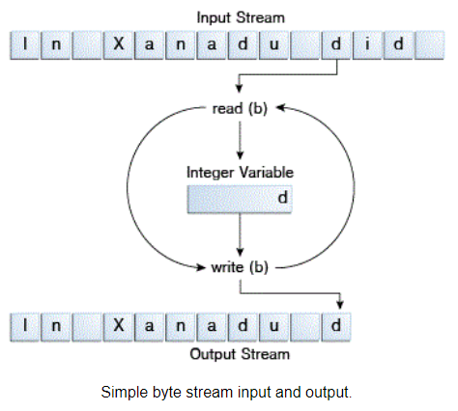
ByteStream
Programs use byte streams to perform input and output of 8-bit bytes.
All byte stream classes are descended from InputStream and OutputStream.
There are many byte stream classes. To demonstrate how byte streams work, our focus is on the file I/O byte streams, FileInputStream and FileOutputStream.

Slide 276
FileOutputStream methods
FileOutputStream is an output stream for writing data/streams of raw bytes to file or storing data to file.
For writing byte-oriented and character-oriented data, we can use FileOutputStream but for writing character-oriented data, FileWriter is more preferred.
Method | Description
void close() | It closes the file output stream.
void write(int b) | It is used to write the specified byte to the file output stream.
void write(byte[] arr) | It is used to write data in bytes of arr[] to file output stream.
void write(byte[] ary, int off, int len) | is used to write the number of bytes equal to length to the output stream from an array starting from the position start.

Slide 277
FileInputStream methods
A FileInputStream obtains input bytes from a file in a file system.
FileInputStream is meant for reading streams of raw bytes such as image data.
Method | Description
close() | Closes this file input stream and releases any system resources associated with it
read() | Reads a byte of data from this input stream
read(byte[] b) | Reads up to b.length bytes of data from this input stream into an array of bytes.
read(byte[] b, int off, int len) | Reads up to len bytes of data from this input stream into an array of bytes.

Slide 278
Demo - Write to File
try (FileOutputStream fout = new FileOutputStream("welcome.txt");) {
String str = "Hello Java";
fout.write(str.getBytes());
} catch (FileNotFoundException e) {
e.printStackTrace();
} catch (IOException e) {
e.printStackTrace();
}

Slide 279
Demo - Read from File
try (FileInputStream fin = new FileInputStream("welcome.txt");) {
int i = 0;
while ((i = fin.read()) != -1) {
System.out.println((char) i);
}
} catch (FileNotFoundException e) {
e.printStackTrace();
} catch (IOException e) {
e.printStackTrace();
}

Slide 280
Character Stream

Slide 281
CharacterStream
Character stream automatically allows us to read/write data character by character.
Though it has many classes, the FileReader and the FileWriter are the most popular ones.
FileReader and FileWriter are character streams used to read from the source and write to the destination respectively.

Slide 282
CharacterStream
Stream Class | Descriptor
BufferedReader | It is used to handle buffered input stream.
FileReader | This is an input stream that reads from file.
InputStreamReader | This input stream is used to translate byte to character.
OutputStreamReader | This output stream is used to translate character to byte.
Reader | This is an abstract class that define character stream input.
PrintWriter | This contains the most used print() and println() method
Writer | This is an abstract class that define character stream output.
BufferedWriter | This is used to handle buffered output stream.
FileWriter | This is used to output stream that writes to file.

Slide 283
CharacterStream
The Java platform stores character values using Unicode conventions. Character stream I/O automatically translates this internal format to and from the local character set.
All character stream classes are descended from Reader and Writer. As with byte streams, there are character stream classes that specialize in file I/O: FileReader and FileWriter.
character stream handles translation between characters and bytes. FileReader, for example, uses FileInputStream, while FileWriter uses FileOutputStream.

Slide 284
FileReader
Reads text from character files using a default buffer size. Decoding from bytes to characters uses either a specified charset or the platform's default charset.
Method | Description
read() | The read() method reads and passes a single character or -1 if the stream is ended.
read(char[] charBuffer, int offset, int length) | It reads a stream of characters and stores them in the given Character Buffer. Offset is the position at which it starts reading and Length is the total number of characters to be read. It passes plenty of characters read or -1 if the stream is ended.
close() | It closes the stream and releases the system resources associated with it.

Slide 285
FileWriter
Writes text to character files using a default buffer size. The FileWriter is meant for writing streams of characters.
Method | Description
void write(String text) | It is used to write the string into FileWriter.
void write(char c) | It is used to write the char into FileWriter.
void write(char[] c) | It is used to write a char array into FileWriter.
void flush() | It is used to flushes the data of FileWriter.
void close() | It is used to close the FileWriter.

Slide 286
Demo - Write to File
try (FileWriter fw = new FileWriter("welcome.txt")) {
fw.write("Hello Java!!!");
} catch (IOException e) {
e.printStackTrace();
}

Slide 287
Demo - Read from File
try (FileReader fr = new FileReader("welcome.txt");
Scanner sc = new Scanner(fr)) {
while(sc.hasNextLine()) {
System.out.println(sc.nextLine());
}
} catch (IOException e) {
e.printStackTrace();
}

Slide 288
Serialization & Deserialization

Slide 289
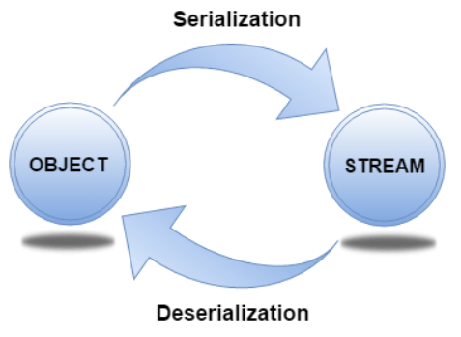
Serialization & Deserialization
Serialization in Java is a mechanism of writing the state of an object into a byte-stream. It is mainly used in Hibernate, RMI, JPA, EJB and JMS technologies.
The reverse operation of serialization is called deserialization where byte-stream is converted into an object.
For serializing the object, we call the writeObject() method of ObjectOutputStream class, and for deserialization we call the readObject() method of ObjectInputStream class

Slide 290
Serialization - Demo
Student s1 = new Student(101, "Akshay");
try (FileOutputStream fout = new FileOutputStream("file.txt");
ObjectOutputStream out = new ObjectOutputStream(fout)) {
out.writeObject(s1);
out.flush();
out.close();
System.out.println("success");
} catch (IOException e) {
e.printStackTrace();
}

Slide 291
Deserialization - Demo
ArrayList<Student> objects = new ArrayList<Student>();
try (FileInputStream fis = new FileInputStream("file.txt");
ObjectInputStream in = new ObjectInputStream(fis);) {
while (true) {
Student s = (Student) in.readObject();
objects.add(s);
}
} catch (EOFException eof) {
} catch (IOException | ClassNotFoundException e) {
e.printStackTrace();
}
objects.forEach((s) -> System.out.println(s));

Slide 292
Generics

Slide 293
What is Generics?
Java generics are mainly used to impose type safety in programs.
Type safety is when the compiler validates the datatype of constants, variables, and methods whether it is rightly assigned or not.
For example, we cannot initialize a variable as an integer and assign a string value to it.
To avoid such mismatch between them, we can restrict the usage of a specific type of object only, like Integer, Float, etc.

Slide 294
What is Generics?
We can initialize a List in two ways in Java.
By not specifying the datatype of the List
List list = new ArrayList();
list.add("Java");
list.add(1234);
Note : 1234 is not a string. How do we make sure we add only Strings? Enter generics, the other way of initializing a List.
By using <>(angular brackets) to specify the data type
List<String> list = new ArrayList<String>();
list.add("Java");
list.add("C++");

Slide 295
What is Generics?
As you can see, '<String>” will make sure that we add only strings in the list and not any other datatype.
If we were to follow the first method, there is a risk of run-time exception when you try to iterate the list and retrieve your desserts but there is an Integer hiding in it.
Once we specify the datatype, we will not be able to add any other data type in the list. Doing so will throw compile time errors.
for (Object obj : list) {
String item = (String) obj;
// above line can result in ClassCastException
// if not type casted to String
}

Slide 296
Syntax and Naming Convention
Following a naming convention helps maintain uniformity in the codebase and facilitates easy readability.
The following are some of the extensively used naming conventions for generic parameters:
E – Element
K – Key (used in map)
N – Number
T – Parameter type
V – Value (used in map)

Slide 297
Java Generics in Map
Generics are used most extensively in Map interfaces in Java to specify the type of parameter in the declaration of a Map.
Let us see an example of using generics in a HashMap and how to iterate it to retrieve values.
Map<Integer, String> map = new HashMap<Integer, String>();
map.put(1, "Value1");
Iterator<String> itr = map.values().iterator();
while (itr.hasNext()) {
System.out.println(itr.next());
}

Slide 298
Java Generics in Map
In the above example, we can see that the HashMap, map stores a <Key, Value> pair consisting of Integer and String respectively.
Here we have used generics to specify the data types for key and value being integer and string respectively.
We can use the iterator object to retrieve values.
If we fail to mention the data types for key and value, it can result in a compile time error during iteration.

Slide 299
Generic Class

Slide 300
Generic Class
The real use of generics in its true sense can be observed in its application of creating classes.
We can create a single class without specifying the data type of its object, in other words, using a generic data type we can create multiple classes with different data types.
Consider the following two ways of setting and getting an item through a class:

Slide 301
Generic Class
class SpecificClass {
private String thing;
public String getThing() {
return thing;
}
public void setThing(String thing) {
this.thing = thing;
}
}
class GenericClass<T> {
private T thing;
public T getThing() {
return thing;
}
public void setThing(T thing) {
this.thing = thing;
}
}

Slide 302
Generic Class
On the left hand side, we can see a class that is used to get and set a string object. This cannot be used to set any other type to the "thing". It makes the code quite rigid and not reusable.
Imagine if you had to create a new class for each kind of data type, it would be tedious. You would have to declare a new class for each kind of data type. On the other hand, the class on the right side is a generic class with a non specific data type as an argument.
You can reuse it to pass any kind of object. All you have to do is specify the data type in the class object and just pass the right data:

Slide 303
Generic Class
public static void main(String[] args) {
//Creating Generic class object with String as parameter
GenericClass<String> book= new GenericClass();
book.setThing("Clean");
//Creating Generic class object with Integer as parameter
GenericClass<Integer> pricing = new GenericClass();
pricing.setThing(150);
}

Slide 304
Generic Interface

Slide 305
Generic Interface
Generics can be used in interfaces as well.
The class implementing the interface can specify the type of parameter for the method.
The following code snippet shows an interface where <T1, T2> are the generic parameters to the interface.
// generic interface definition
interface DemoInterface<T1, T2> {
T2 doSomething(T1 t);
T2 doAnotherThing(T1 t);
}

Slide 306
Generic Interface
// class implementing generic interface
class DemoClass implements DemoInterface<String, Integer> {
@Override
public Integer doSomething(String t) {
// TODO Auto-generated method stub
return null;
}
@Override
public Integer doAnotherThing(String t) {
// TODO Auto-generated method stub
return null;
}
}

Slide 307
Generic Interface
The class DemoClass implements the interface DemoInterface by passing String and Integer corresponding to T1's and T2's data type respectively.
Similarly, any number of classes implementing the interface can use different data types like Integer , Float , Objects etc

Slide 308
Generic Method

Slide 309
Generic Method
As the name suggests, the type can be passed through a method or constructor.
We can declare a generic method that can be called with arguments of different types.
Based on the type of parameter passed to the method, the compiler will handle the method call appropriately.
If we don't want the whole class to be parameterized, we can make only methods generic.

Slide 310
Generic Method
static <T> void print(T element) {
System.out.println(element);
}
public static void main(String[] args) {
print(55);
print("Hello Java!");
}

Slide 311
Generics and Inheritance
There are some rules to be followed while making a generic type class as a subclass or superclass.
A generic class can extend a non generic class.
class NonGenericClass {
// …
}
class GenericClass<T> extends NonGenericClass {
// generic class extending non-generic class
}
A generic class can extend other classes, provided it has the same type of parameter.

Slide 312
Generics and Inheritance
class genericSuperClass<T> {
}
//subclass with same type parameter
class genericSubClass<T> extends GenericSuperClass<T> {
}
//subclass with two type parameters
class genericSubClass<T, V> extends GenericSuperClass<T> {
}
//Compile time error due to the subclass having a different types of parameters
class genericSubClass<T1, T2> extends GenericSuperClass<T> {
}
Note : Non Generic classes cannot extend generic classes unless the generic class has predefined parameters.

Slide 313
Generics and Inheritance
class genericSuperClass<T> {
}
//Compile time error, the non generic class can't extend the generic class
class nonGenericClass extends genericSuperClass<T> {
}
//Predefined class
class P {
}
//Generic class with predefined type P as parameter
class genericSuperClass<P> {
}
//Allowed
class nonGenericClass extends genericSuperClass<P> {
}

Slide 314
Generic Subtyping
In object oriented programming languages, A is said to be a subtype of B if A extends or implements B.
The bottom line is, subtyping is not allowed in parameterized types of generic.
Let us understand what this means with an example.
//Allowed
List<Number> numbers = new ArrayList<Number>();
//Not Allowed. Incompatible Type error
List<Number> numbers = new ArrayList<Integer>();

Slide 315
Generic Subtyping
In the first kind of initialization, we can add Integers, Float, Double objects, or any sub-types of Number into the array numbers. However, we cannot initialize an array of type Numbers and assign it to an ArrayList with a subtype of Integer as a parameter.
When type arguments are different, generics of the same type are not compatible with each other. For example, as seen below, the List<HimalayanCat> is not a subtype of List<Cat>, even though HimalayanCat is a subtype of Cat. There is no relationship between these lists and List<HimalayanCat> is not assignable to List<Cat>.

Slide 316
Generic Subtyping
private static void print(List<Cat> c) {
}
public static void main(String[] args) {
List<Cat> cat = new ArrayList<>();
List<HimalayanCat> hCat = new ArrayList<>();
print(cat);
// error while trying to pass list of the HimalayanCat
// into a method expecting List of type Cat
print(hCat);
}

Slide 317
Wildcards

Slide 318
Generics with Wildcards
Have you ever wondered how to represent an unknown type?
For example, you are defining a class or an interface and you don't know which type should be used. How would you handle this in Java?
In addition to this, different generic types are not compatible with each other.
How do we solve all those problems?
Enter wildcard. The “?” (question mark) is known as wildcard.
We can represent an initially unknown data type using this.
There are 3 kinds of wildcards:
Upper bounded Wildcards
Lower Bounded Wildcard
Unbounded Type

Slide 319
Upper-Bounded Wildcards
These kinds of wildcards are used when you are unsure about how an input data format is but you know what kind of data the user will enter.
For example, you want to calculate the sum of a list but the list could be of type Double, Integer, Float and you should be able to handle all these conditions.
This is where you use upper bound wildcards. They are used to relax the restriction of a variable type.
To declare an upper-bounded wildcards, use the wildcard character ‘?’, followed by the extends keyword, followed by its upper bound.

Slide 320
Upper-Bounded Wildcards
private static double sum(List<? extends Number> list) {
double sum = 0;
for (Number itr : list) {
sum += itr.doubleValue();
}
return sum;
}
public static void main(String[] args) {
List<Integer> intList = Arrays.asList(34, 76, 2, 1, 65);
System.out.println("Sum = " + sum(intList));
List<Double> doubleList = Arrays.asList(13.2, 57.4, 64.3, 23.6);
System.out.println("Sum = " + sum(doubleList));
}

Slide 321
Lower-Bounded Wildcards
Imagine a situation where you want to expand the scope of a type.
For example, you want to accept Integer but at the same time, you want to accept Number and Object too. How would you do this? Enter Lower bounded wildcard.
These are used to widen the scope of a type of variable. Using this we can pass the lower bound and its supertypes.
The way we do this is again by using a ‘?’ operator followed by the super keyword and then the lower bound class.

Slide 322
Lower-Bounded Wildcards
private static void print(List<? super Integer> list) {
System.out.println(list);
}
public static void main(String[] args) {
List<Integer> intList = Arrays.asList(25, 45, 87, 96);
print(intList);
List<Number> numberList = Arrays.asList(10, 20, 30, 40);
print(numberList);
}
Here, we are just printing the list of elements that are passed in. But notice that we can pass Number and Integer both instead of just an Integer. However, if we pass Double it will throw an error as Double is not a superclass of Integer. When we use Lower bound you can only pass the class itself or its superclass objects.

Slide 323
Unbounded Type
Let’s now see a situation where your operation has nothing to do with a type.
A quick example could be the example we saw earlier of printing a list.
Printing a list is a simple operation irrespective of the data type.
Broadly speaking, use this wildcard when the code inside the method is using the Object functionality but the code inside the method doesn’t depend on the data type of the parameter passed in.
The way to do this is just putting a ‘?’

Slide 324
Unbounded Type
private static void print(List<?> list) {
System.out.println(list);
}
public static void main(String[] args) {
List<Integer> intList = Arrays.asList(25, 45, 87, 96);
print(intList);
List<Double> numberList = Arrays.asList(34.65, 54.12, 65.12, 76.98);
print(numberList);
}

Slide 325
Generics and Primitive Data Types
Generics cannot be used with primitive data types like int, double, float.
You can use the respective wrapper classes for the data types.
Wrapper classes are used to wrap a primitive value into a wrapper class object. Ex - Integer class for int primitive type.
// Not allowed
List<int> numbers = new ArrayList<>();
// Allowed
List<Integer> numbers = new ArrayList<>();

Slide 326
Advantages of Generics
Code Reusability
As we have seen from multiple instances above, we can use generics to create a single class, methods, interface for multiple types.
This is essentially using the same piece of code to cater to multiple scenarios without code duplication.
Type Safety
The very need for generics arose from trying to avoid type mismatch exceptions.
Type safety is the crux of generics by abstracting the data type.
Individual Type Casting is not Needed
Typecasting is not needed each time we create a new instance of a class.
Compile time Type Checking
Using generics allows us to save time by reducing debugging during run time.
If there is a type mismatch between the declared variable and the type of the value passed, then the compiler throws an error even before the code is executed.
Used with Collections, the most extensive use case for generics is with the many Collections available in Java.

Slide 327
What is not Allowed in Generics
You cannot create the static type of generic.
You cannot create instance of T.
Generics are not compatible with primitive in declarations (Instead we need to use the wrapper classes for those respective types).
You can’t create generic exception class. A generic class cannot extend Throwable class directly or indirectly.

Slide 328
Collection Framework

Slide 329
Collection Framework
The Collection in Java is a framework that provides an architecture to store and manipulate the group of objects.
Java Collections can achieve all the operations that you perform on a data such as searching, sorting, insertion, manipulation, and deletion.
The java.util package contains the powerful tool of Collections Framework.
The Collection framework has:
Interfaces and its implementations, i.e., classes
Algorithms

Slide 330
Collection Framework
Iterable
Interface
Class
Collection
List
Queue
Set
PriorityQueue
ArrayList
HashSet
Deque
LinkedList
LinkedHashSet
Vector
ArrayDeque
SortedSet
Stack
TreeSet

Slide 331
Collection Interface

Slide 332
Collection Interface
The Collection Interface is the root or the foundation on which the Collections Framework is built.
It is a general interface that has the declaration:
interface Collection<E>
Here, E is the type of object that the collection will hold.
It provides the basic operations like adding, removing, clearing the elements in a collection, checking whether the collection is empty etc.
List, Queue and Set are the components that extend the Collection Interface.

Slide 333
Method of Collection Interface
Method | Description
public boolean add(E e) | It is used to insert an element in this collection
public boolean addAll(Collection<? extends E> c) | It is used to insert the specified collection elements in the invoking collection
public boolean remove(Object element) | It is used to delete an element from the collection.
public boolean removeAll(Collection<?> c) | It is used to delete all the elements of the specified collection from the invoking collection.
default boolean removeIf(Predicate<? super E> filter) | It is used to delete all the elements of the collection that satisfy the specified predicate.
public boolean retainAll(Collection<?> c) | It is used to delete all the elements of invoking collection except the specified collection.

Slide 334
Method of Collection Interface
Method | Description
public int size() | It returns the total number of elements in the collection.
public void clear() | It removes the total number of elements from the collection.
public boolean contains(Object element) | It is used to search an element.
public boolean containsAll(Collection<?> c) | It is used to search the specified collection in the collection.
public Iterator iterator() | It returns an iterator.
public Object[] toArray() | It converts collection into array.

Slide 335
Method of Collection Interface
Method | Description
public <T> T[] toArray(T[] a) | It converts collection into array. Here, the runtime type of the returned array is that of the specified array.
public boolean isEmpty() | It checks if collection is empty.
public boolean equals(Object element) | It matches two collections.
public int hashCode() | It returns the hash code number of the collection.

Slide 336
List Interface

Slide 337
List Interface
This is a child interface of the collection interface.
This interface is dedicated to the data of the list type in which we can store all the ordered collection of the objects.
This also allows duplicate data to be present in it.

Slide 338
ArrayList
ArrayList provides us with dynamic arrays in Java.
Though, it may be slower than standard arrays but can be helpful in programs where lots of manipulation in the array is needed.
The size of an ArrayList is increased automatically if the collection grows or shrinks if the objects are removed from the collection.
It can contain duplicate elements.
Insertion order is maintained.
Manipulation of elements is little bit slower, because lot of shifting is needed.
It allows random access (works on index basis)

Slide 339
ArrayList
Using add method
List<String> list = new ArrayList<String>();
list.add("Java");
list.add("C++");
Using asList()
List<String> list = new ArrayList<String>(Arrays.asList("Java", "C++"));
Using list.of()
List<String> list = new ArrayList<String>(List.of("Java", "C++"));

Slide 340
Methods of ArrayList
Method | Description
size() | Returns the length of the arraylist.
sort() | Sort the arraylist elements.
clone() | Creates a new arraylist with the same element, size, and capacity.
contains() | Searches the arraylist for the specified element and returns a boolean result.
ensureCapacity() | Specifies the total element the arraylist can contain.
isEmpty() | Checks if the arraylist is empty.
indexOf() | Searches a specified element in an arraylist and returns the index of the element.

Slide 341
LinkedList
Linked List is a linear data structure where the elements are called as nodes.
Here, each node has two fields- data and next. Data stores the actual piece of information and next points to the next node. 'Next' field is actually the address of the next node.
The LinkedList class extends the AbstractSequentialList and it also extends the List, Deque and Queue interface.
Head
A
B
C
D
E
NULL
Data
Next

Slide 342
LinkedList
LinkedList can contain duplicate elements.
It maintains insertion order of the elements.
Manipulation is faster as no shifting is needed.
It allows random access (works on index basis)

Slide 343
Vector
A vector provides us with dynamic arrays in Java. Though, it may be slower than standard arrays but can be helpful in programs where lots of manipulation in the array is needed.
This is identical to ArrayList in terms of implementation.
However, the primary difference between a vector and an ArrayList is that a Vector is synchronized and an ArrayList is non-synchronized.
It can contain duplicate elements.
It maintains insertion order.
Manipulation is faster as no shifting is needed.
It allows random access (works on index basis)

Slide 344
Methods of Vector
Method | Description
add(element) | adds an element to vectors
add(index, element) | adds an element to the specified position
addAll(vector) | adds all elements of a vector to another vector
get(index) | returns an element specified by the index
iterator() | returns an iterator object to sequentially access vector elements
remove(index) | removes an element from specified position
removeAll() | removes all the elements
clear() | removes all elements. It is more efficient than removeAll()

Slide 345
Stack
In stack, elements are stored and accessed in Last In First Out manner. That is, elements are added to the top of the stack and removed from the top of the stack.
Method | Description
empty() | The method checks the stack is empty or not.
push(E item) | The method pushes (insert) an element onto the top of the stack.
pop() | The method removes an element from the top of the stack and returns the same element as the value of that function.
peek() | The method looks at the top element of the stack without removing it.
search(Object o) | The method searches the specified object and returns the position of the object.

Slide 346
Set

Slide 347
Set
The Set interface defines an unordered collection.
We cannot store duplicate values in this.
The Set Interface is implemented by popular classes like HashedSet, LinkedHashSet and TreeSet.

Slide 348
HashSet
Contains unique values only
Doesn’t maintain insertion order
Best for search operations
Default capacity is 10 and load factor is 0.75
Union - adds all elements in one set → addAll()
Intersection - returns all common elements → retainAll()
Difference - removes common elements from first set → removeAll()

Slide 349
LinkedHashSet
Contains unique values only
Maintains insertion order
Best for search operations
Default capacity is 10 and load factor is 0.75

Slide 350
TreeSet
Contains unique elements only
Null values are not allowed
Maintains ascending order

Slide 351
Queue

Slide 352
Queue
In queues, elements are stored and accessed in First In, First Out manner. That is, elements are added from the behind and removed from the front.
LinkedList implementation of Queue
Queue<String> animal1 = new LinkedList<>();
Array implementation of Queue
Queue<String> animal2 = new ArrayDeque<>();
Priority Queue implementation of Queue
Queue<String> animal3 = new PriorityQueue<>();

Slide 353
Methods of Queue
Method | Description
add() | Inserts the specified element into the queue. If the task is successful, add() returns true, if not it throws an exception
offer() | Inserts the specified element into the queue. If the task is successful, offer() returns true, if not it returns false.
element() | Returns the head of the queue. Throws an exception if the queue is empty.
peek() | Returns the head of the queue. Returns null if the queue is empty.
remove() | Returns and removes the head of the queue. Throws an exception if the queue is empty.
poll() | Returns and removes the head of the queue. Returns null if the queue is empty.

Slide 354
Priority Queue
The PriorityQueue class extends AbstractQueue and implements the Queue Interface.
As the name suggests, they follow the principle of priority of the elements.
We know that we follow First-In,First-Out for queues, but at times, the elements needs to be processed in terms of their priority. This is where the PriorityQueue comes into play.
It does not allow null values to be stored inside it.
The add() method is used to add an element
The poll() method is used to remove the top-most element.
The peek() is used to display the top-most element.

Slide 355
Dequeue
In a regular queue, elements are added from the rear and removed from the front. However, in a deque, we can insert and remove elements from both front and rear.
Array implementation of Deque
Deque<String> queue = new ArrayDeque<>();
LinkedList implementation of Deque
Deque<String> queue = new LinkedList<>();
Addition
Addition
Deletion
Deletion
front
rear

Slide 356
ArrayDeque
ArrayDeque is a deque implementation in Java that belongs to the java.util package. It is the resizable array implementation of the Deque interface.
ArrayDeque doesn't have any capacity constraints and grows based on the requirement. null values cannot be stored in an ArrayDeque. The initial capacity of an ArrayDeque object is 16.

Slide 357
LinkedList Deque
LinkedList is a deque implementation in Java that belongs to the java.util package. It uses a doubly linked list to store the elements. The elements are stored in nodes and linked together via pointers i.e the address of the next node will be stored in the previous node.
LinkedList doesn't require the size to be specified while creating. The size of the list is automatically increased or decreased when an element is added or removed respectively.

Slide 358
Dequeue
Besides methods available in the Queue interface, the Deque interface also includes the following methods:
addFirst() - Adds the specified element at the beginning of the deque. Throws an exception if the deque is full.
addLast() - Adds the specified element at the end of the deque. Throws an exception if the deque is full.
offerFirst() - Adds the specified element at the beginning of the deque. Returns false if the deque is full.
offerLast() - Adds the specified element at the end of the deque. Returns false if the deque is full.
getFirst() - Returns the first element of the deque. Throws an exception if the deque is empty.
getLast() - Returns the last element of the deque. Throws an exception if the deque is empty.

Slide 359
Dequeue
peekFirst() - Returns the first element of the deque. Returns null if the deque is empty.
peekLast() - Returns the last element of the deque. Returns null if the deque is empty.
removeFirst() - Returns and removes the first element of the deque. Throws an exception if the deque is empty.
removeLast() - Returns and removes the last element of the deque. Throws an exception if the deque is empty.
pollFirst() - Returns and removes the first element of the deque. Returns null if the deque is empty.
pollLast() - Returns and removes the last element of the deque. Returns null if the deque is empty.

Slide 360
Map

Slide 361
Map
In Java, elements of Map are stored in key/value pairs. Keys are unique values associated with individual Values.
Map
HashMap
TreeMap
LinkedHashMap

Slide 362
Methods of Map
Method | Description
V put(Object key, Object value) | It is used to insert an entry in the map.
void putAll(Map map) | It is used to insert the specified map in the map.
V putIfAbsent(K key, V value) | It inserts the specified value with the specified key in the map only if it is not already specified.
V remove(Object key) | It is used to delete an entry for the specified key.
boolean remove(Object key, Object value) | It removes the specified values with the associated specified keys from the map.
Set keySet() | It returns the Set view containing all the keys.
Set<Map.Entry<K,V>> entrySet() | It returns the Set view containing all the keys and values.

Slide 363
Methods of Map
Method | Description
void clear() | It is used to reset the map.
boolean containsValue(Object value) | This method returns true if some value equal to the value exists within the map, else return false.
boolean containsKey(Object key) | This method returns true if some key equal to the key exists within the map, else return false.
boolean equals(Object o) | It is used to compare the specified Object with the Map.
int size() | This method returns the number of entries in the map.
V get(Object key) | This method returns the object that contains the value associated with the key.

Slide 364
Collection Overview
 | Elements Ordered | Allow Duplicates | Elements added/removed in a certain order | Allows Key/Values
List | Yes - Numbered Index | Yes | No | No
Set | No | No | No | No
Queue | Yes - Placed Order | Yes | Yes | No
Map | No | Yes - Values only | No | Yes

Slide 365
Collection Overview
 | Parent Interface | Allows null? | Elements Sorted? | Uses hashCode? | Uses compareTo?
ArrayList | List | Yes | No | No | No
LinkedList | List & Queue | Yes | No | No | No
HashSet | Set | Yes | No | Yes | No
TreeSet | Set | No | Yes | No | Yes
HashMap | Map | Yes | No | Yes | No
TreeMap | Map | No | Yes | No | Yes

Slide 366
Algorithms

Slide 367
Algorithms in Collection Framework
The collections framework provides several high-performance algorithms for manipulating collection elements.
These algorithms are implemented as static methods of class Collections.
Algorithms sort, binarySearch, reverse, shuffle, fill and copy operate on Lists.
Algorithms min, max, addAll, frequency and disjoint operate on Collections.

Slide 368
Methods of Algorithms
Method | Description
static int binarySearch(List list, Object value, Comparator c) | Searches for value in the list ordered according to c. Returns the position of value in list, or -1 if value is not found.
static int binarySearch(List list, Object value) | Searches for value in the list. The list must be sorted. Returns the position of value in list, or -1 if value is not found.
static void copy(List list1, List list2) | Copies the elements of list2 to list1.
static Enumeration enumeration(Collection c) | Returns an enumeration over c.
static void fill(List list, Object obj) | Assigns obj to each element of the list.

Slide 369
Methods of Algorithms
Method | Description
static int indexOfSubList(List list, List subList) | Searches list for the first occurrence of subList. Returns the index of the first match, or .1 if no match is found.
static int lastIndexOfSubList(List list, List subList) | Searches list for the last occurrence of subList. Returns the index of the last match, or .1 if no match is found.
static ArrayList list(Enumeration enum) | Returns an ArrayList that contains the elements of enum.
static Object max(Collection c, Comparator comp) | Returns the maximum element in c as determined by comp.

Slide 370
Methods of Algorithms
Method | Description
static Object max(Collection c) | Returns the maximum element in c as determined by natural ordering. The collection need not be sorted.
static Object min(Collection c, Comparator comp) | Returns the minimum element in c as determined by comp. The collection need not be sorted.
static Object min(Collection c) | Returns the minimum element in c as determined by natural ordering.
static List nCopies(int num, Object obj) | Returns num copies of obj contained in an immutable list. num must be greater than or equal to zero.
static void reverse(List list) | Reverses the sequence in list.

Slide 371
Methods of Algorithms
Method | Description
static boolean replaceAll(List list, Object old, Object new) | Replaces all occurrences of old with new in the list. Returns true if at least one replacement occurred. Returns false, otherwise.
static Comparator reverseOrder() | Returns a reverse comparator.
static void rotate(List list, int n) | Rotates list by n places to the right. To rotate left, use a negative value for n.
static void shuffle(List list, Random r) | Shuffles (i.e., randomizes) the elements in the list by using r as a source of random numbers.
static void sort(List list, Comparator comp) | Sorts the elements of list as determined by comp.

Slide 372
Methods of Algorithms
Method | Description
static void sort(List list) | Sorts the elements of the list as determined by their natural ordering.
static void swap(List list, int idx1, int idx2) | Exchanges the elements in the list at the indices specified by idx1 and idx2.
static Collection unmodifiableCollection(Collection c) | Returns an unmodifiable collection backed by c.

Slide 373
Comparable and Comparator

Slide 374
Comparable Interface
A comparable object is capable of comparing itself with another object.
The class itself must implements the java.lang.Comparable interface to compare its instances.
Ex. Consider a Movie class that has members like, rating, name, year. Suppose we wish to sort a list of Movies based on year of release. We can implement the Comparable interface with the Movie class, and we override the method compareTo() of Comparable interface.

Slide 375
Comparator Interface
Unlike Comparable, Comparator is external to the element type we are comparing.
It’s a separate class.
We create multiple separate classes (that implement Comparator) to compare by different members.
Collections class has a second sort() method and it takes Comparator.
The sort() method invokes the compare() to sort objects.
To compare objects:
Create a class that implements Comparator (and thus the compare() method that does the work previously done by compareTo()).
Make an instance of the Comparator class.
Call the overloaded sort() method, giving it both the list and the instance of the class that implements Comparator.

Slide 376
Comparable vs Comparator
Comparable | Comparator
Comparable provides a single sorting sequence. In other words, we can sort the collection on the basis of a single element such as id, name, and price | The Comparator provides multiple sorting sequences. In other words, we can sort the collection on the basis of multiple elements such as id, name, and price etc.
Comparable affects the original class, i.e., the actual class is modified. | Comparator doesn't affect the original class, i.e., the actual class is not modified.
Comparable provides compareTo() method to sort elements. | Comparator provides compare() method to sort elements.
Comparable is present in java.lang package. | A Comparator is present in the java.util package.
We can sort the list elements of Comparable type by Collections.sort(List) method. | We can sort the list elements of Comparator type by Collections.sort(List, Comparator) method.

Slide 377
Iterator Interface

Slide 378
Iterator Interface
Iterator is an object that can be used to loop through collections.
As the name suggests, it is used to iterate over the elements.
It is used to modify and iterate over the elements in a collection.
There are 3 methods in the Iterator interface :
public Object next()- It returns the next element in the collection. It throws the exception of NoSuchElementException if there is no next element.
public void remove()- It removes the current element from the collection.
public boolean hasNext()- It returns true if there are more elements in the collection. Else, returns false.

Slide 379
Iterable Interface
There are three ways in which objects of Iterable can be iterated.
Using enhanced for loop(for-each loop)
for (String item : list) {
System.out.println(item);
}
Using Iterable forEach loop
list.forEach((item) -> {
System.out.println(item);
});
Using Iterator<T> interface
Iterator<String> it = list.iterator();
while (it.hasNext()) {
String item = it.next();
System.out.println(item);
}

Slide 380
JDBC

Slide 381
Overview
JDBC stands for Java Database Connectivity is a Java API(Application Programming Interface) used to interact with databases.
JDBC is a specification from Sun Microsystems and it is used by Java applications to communicate with relational databases.
We can use JDBC to execute queries on various databases and perform operations like SELECT , INSERT , UPDATE and DELETE
JDBC API helps Java applications interact with different databases like MSSQL, ORACLE, MYSQL, etc.
It consists of classes and interfaces of JDBC that allow the applications to access databases and send requests made by users to the specified database.

Slide 382
Purpose of JDBC
Java programming language is used to develop enterprise applications. These applications are developed with intention of solving real life problems and need to interact with databases to store required data and perform operations on it.
Hence, to interact with databases there is a need for efficient database connectivity, ODBC(Open Database Connectivity) driver is used for the same.
ODBC is an API introduced by Microsoft and used to interact with databases. It can be used by only the windows platform and can be used for any language like C, C++, Java, etc. ODBC is procedural.
JDBC is an API with classes and interfaces used to interact with databases. It is used only for Java languages and can be used for any platform. JDBC is highly recommended for Java applications as there are no performance or platform dependency problems.

Slide 383
Components of JDBC
JDBC API
JDBC API is a collection of various classes, methods, and interfaces for easy communication with a database. JDBC API provides two different packages to connect with different databases.
JDBC Driver Manager
JDBC DriverManager is a class in JDBC API that loads a database specific driver in Java application and establishes a connection with a database. DriverManager makes a call to a specific database to process the user request.
JDBC Test Suite
JDBC Test Suite is used to test operations being performed on databases using JDBC drivers. JDBC Test Suite tests operations such as insertion, updating, and deletion.

Slide 384
Components of JDBC
JDBC ODBC Bridge Drivers:
As the name suggests JDBC-ODBC Bridge Drivers are used to translate JDBC methods to ODBC function calls.
JDBC-ODBC Bridge Drivers are used to connect database drivers to the database.
Even after using JDBC for Java Enterprise Applications, we need an ODBC connection for connecting with databases.
JDBC-ODBC Bridge Drivers are used to bridge the same gap between JDBC and ODBC drivers.
The bridge translates the object oriented JDBC method call to the procedural ODBC function call.
It makes use of the sun.jdbc.odbc package.
This package includes a native library to access ODBC characteristics.

Slide 385
Architecture of JDBC

Slide 386
Architecture of JDBC
Java Application
JDBC API
JDBC Driver Manager
JDBC Driver
JDBC Driver
JDBC Driver
Oracle
MySQL
SQL Server

Slide 387
Architecture of JDBC
Application
Applications in JDBC architecture are java applications like applets or servlet that communicates with databases.
JDBC API
The JDBC API is an Application Programming Interface used to create Databases . JDBC API uses classes and interfaces to connect with databases. Some of the important classes and interfaces defined in JDBC architecture in java are the DriverManager class, Connection Interface, etc.
DriverManager
DriverManager class in the JDBC architecture is used to establish a connection between Java applications and databases. Using the getConnection method of this class a connection is established between the Java application and data sources.

Slide 388
Architecture of JDBC
JDBC Drivers
JDBC drivers are used to connecting with data sources. All databases like Oracle, MSSQL, MYSQL, etc. have their drivers, to connect with these databases we need to load their specific drivers. Class is a java class used to load drivers. Class.forName method is used to load drivers in JDBC architecture.
Data Sources
Data Sources in the JDBC architecture are the databases that we can connect using this API. These are the sources where data is stored and used by Java applications. JDBC API helps to connect various databases like Oracle, MYSQL, MSSQL, PostgreSQL, etc.

Slide 389
Types of JDBC Architecture
2 Tier Model
2-tier JDBC architecture model is a basic model.
In this model, a java application communicates directly to the data sources.
JDBC driver is used to establish a connection between the application and the data source.
When an application needs to interact with a database, a query is directly executed on the data source and the output of the queries is sent back to the user in form of results.
In this model, the data source can be located on a different machine connected to the same network the user is connected to.
This model is also known as a client/server configuration. Here user’s machine acts as a client and the machine on which the database is located acts as a server.
Java Application
Client Machine
JDBC
DBMS
Database Server

Slide 390
Types of JDBC Architecture
3 Tier Model
3-tier model is a complex and more secure model of JDBC architecture in Java.
In this model, the user queries are sent to the middle tier and then they are executed on the data source.
Here, the java application is considered as one tier connected to the data source (3rd tier) using middle-tier services.
In this model, the user queries are sent to the data source using middle-tier services, from where the commands are again sent to database for execution.
The results obtained on the database are again sent to the middle-tier and then to the user/application.
Java Applet or HTML Server
Client Machine (GUI)
Application Server
Server Machine
JDBC
DBMS
Database Server

Slide 391
Interfaces and Classes of JDBC API

Slide 392
Interfaces of JDBC API
Driver Interface
The JDBC driver interface provides implementation of the abstract classes such as java.sql.connection, Statement, PreparedStatement, Driver etc provided by JDBC API.
Connection Interface
The connection interface is used to create a connection with the database. getConnection() method of DriverManager class of the Connection interface is used to get a Connection object.
Statement Interface
The statement interface provides methods to execute SQL queries on the database. executeQuery(), executeUpdate() methods of Statement interface are used to run SQL queries on the database.

Slide 393
Interfaces of JDBC API
ResultSet Interface
Resultset interface is used to store and display the result obtained by executing a SQL query on the database. executeQuery() method of Statement interface returns a resultset object.
RowSet Interface
RowSet interface is a component of Java Bean. It is a wrapper of ResultSet and is used to keep data in tabular form.
ResultSetMetaData Interface
Metadata means data about data. ResultSetMetaData interface is used to get information about the resultset interface. The object of the ResultSetMetaData interface provides metadata of resultset like number of columns, column names, total records, etc.
DatabaseMetaData Interface
DatabaseMetaData interface is used to get information about the database vendor being used. It provides metadata like database product name, database product version, total tables/views in the database, the driver used to connect to the database, etc.

Slide 394
Classes of JDBC API
DriverManager class
This class is a member of the java.sql package. It is used to establish connection between the database and its driver.
Blob class
java.sql.Blob is a binary large object that can store large amounts of binary data, such as images or other types of files. Fields defined as TEXT also holds large amounts of data.
Clob class
The java.sql.Clob interface of the JDBC API represents the CLOB datatype. Since the Clob object in JDBC is implemented using as SQL locator, it holds a logical pointer to the SQL CLOB (not the data).
Types classes
Types class define and store constants that are used to identify generic SQL types also known as JDBC types.

Slide 395
Working of JDBC

Slide 396
Working of JDBC
Java applications needs to be programmed for interacting with data sources.
JDBC Drivers for specific databases are to be loaded in a java application for JDBC support which can be done dynamically at run time.
These JDBC drivers communicate with the respective data source.

Slide 397
Working of JDBC
Steps to connect a Java program using JDBC API.
Load Driver : Load JDBC Driver for specific databases using forName() method of class ‘Class’.
Class.forName(“com.mysql.jdbc.Driver”);
Create Connection: create a connection with a database using DriverManager class. Database credentials are to be passed while establishing the connection.
Connection con = DriverManager.getConnection();
Create Query : to manipulate the database we need to create a query using commands like INSERT, UPDATE, DELETE etc. These are created and stored in the string format.
String query = “INSERT INTO Student(name, rollNo) values (“ABC”, 25)”;

Slide 398
Working of JDBC
Create Statement : The query we have created is in the form of String. To perform the operations in the string on a database, we need to fire that query on the database. To achieve this, we need to convert a string object into SQL statement. This can be done using createStatement() and prepareStatement() methods
Statement st = connection.prepareStatement();
Execute Statement : To execute SQL statements on the database, we can use 2 methods depending on which type of query we are executing.
executeUpdate() : this method is used to execute queries like insert, update, delete.
int result = st.executeUpdate(query);
executeQuery() : this method is used to execute queries used to display data from the database, such as select.
ResultSet rs = st.executeQuery(query);
Closing Statement : After performing operations on the database, it is better to close every interface object to avoid further conflicts.
con.close()

Slide 399
Insert
public static void main(String[] args) {
String driver = "com.mysql.cj.jdbc.Driver";
String url = "jdbc:mysql://localhost:3306/lpu";
String username = "root";
String password = "root";
try {
// step 1 : register the driver
Class.forName(driver);
// step 2 : establish the connection
Connection connection = DriverManager.getConnection(url, username, password);
Statement stat = connection.createStatement();
// step 3 : prepare a query
String query = "insert into employees values(102,'Vikas',987648.45)";
// step 4 : execute the query
int result = stat.executeUpdate(query);
if (result > 0)
System.out.println("Added");
else
System.out.println("Failed");
// step 5 : close all resources
stat.close();
connection.close();
} catch (ClassNotFoundException | SQLException e) {
e.printStackTrace();
}
}

Slide 400
Read
public static void main(String[] args) {
String driver = "com.mysql.cj.jdbc.Driver";
String url = "jdbc:mysql://localhost:3306/lpu";
String username = "root";
String password = "root";
try {
Class.forName(driver);
Connection con = DriverManager.getConnection(url, username, password);
Statement stat = con.createStatement();
String query = "select * from employees";
ResultSet rs = stat.executeQuery(query);
while (rs.next()) {
System.out.print(rs.getInt(1));
System.out.print(", " + rs.getString(2));
System.out.println(", " + rs.getDouble(3));
}
stat.close();
con.close();
} catch (ClassNotFoundException | SQLException e) {
e.printStackTrace();
}
}

Slide 401
Bulk Add
try {
Class.forName(driver);
Connection con = DriverManager.getConnection(url, username, password);
Statement stat = con.createStatement();
String q1 = "insert into employees (name, salary) values ('Narayana Patel', '98794.45')";
String q2 = "insert into employees (name, salary) values ('Shanti Das', '32557.68')";
String q3 = "insert into employees (name, salary) values ('Ravi Mishra', '687478.69')";
stat.addBatch(q1);
stat.addBatch(q2);
stat.addBatch(q3);
stat.executeBatch();
System.out.println("Added");
stat.close();
con.close();
} catch (ClassNotFoundException | SQLException e) {
e.printStackTrace();
}

Slide 402
Prepared Statement - Select
String query = "select * from employees where id=?";
PreparedStatement stat = con.prepareStatement(query);
stat.setInt(1, 101);
ResultSet rs = stat.executeQuery();
if (rs.next()) {
System.out.println(rs.getInt(1) + ", " + rs.getString(2) + ", " + rs.getDouble(3));
} else {
System.out.println("Record Not Found!");
}

Slide 403
Prepared Statement - Update
String query = "update employees set salary=? where id=?";
PreparedStatement stat = con.prepareStatement(query);
stat.setDouble(1, 554466.33);
stat.setInt(2, 101);
int rs = stat.executeUpdate();
if (rs > 0) {
System.out.println("Record updated");
} else {
System.out.println("Failed to update");
}

Slide 404
THANK YOU

